Slide 1
FDE Midterm Report
Name Display, UFDE & Rabbit, SMIMS Engine, FDE-CLI, I2C
Jimmy Wang (王俊崴) 22302016002
Notes:
Good afternoon, everyone, my name is Jimmy Wang from software engineering, and this is my FDE midterm report.

Slide 2
Agenda
Experiment 1: Name Display
Experiment 2: Introduction
SMIMS VLFD Driver in Rust
SMIMS Engine
FDE-CLI
I2C
Notes:
This is the rough agenda for today.
I will briefly talk about the first name display experiment, and then move on to experiment 2 which comprises of a software part (FDE-CLI) and a hardware part (I2C).

Slide 3
Name Display
Objective
Display our name on the 7-segment text LCD
Methodology
Generate the Verilog code for each sentence to be displayed
For each sentence
Generate a Verilog case block that assigns values to temporary registers (tmp0, tmp1, …)
A multiplexer selects which sentence (temporary register) to display
Notes:
For the name display experiment, this is probably the same for everyone, our goal is to display our name or any other text on a 7-segment text LCD.
Since I don’t really like hand writing Verilog code, I wrote a script in Python that generates the Verilog code for each sentence that I want to display.
For each sentence, a Verilog case block that assigns values to temporary registers is generated, then a multiplexer selects which sentence to display.

Slide 4
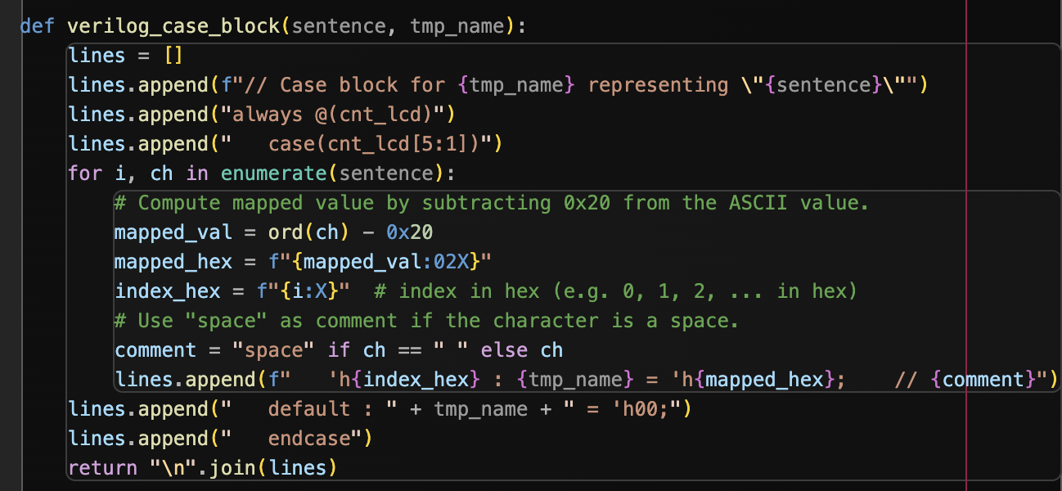
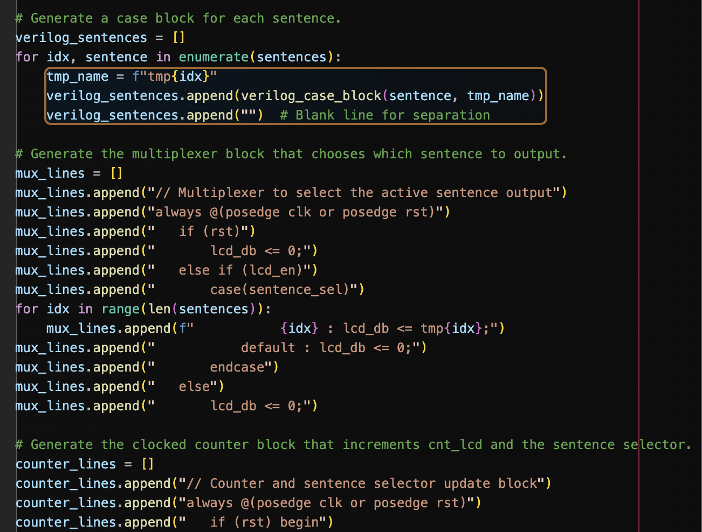
Script
Generating the case block for each character in the string
Generating the multiplexer for the temporary registers
Notes:
Here are some snippets of the Python script.
For the first image, a Verilog case block is generated for each sentence based on the ASCII value for each character subtracted by 0x20.
And the second image shows code generation for a multiplexer selects which sentence to display.

Slide 5
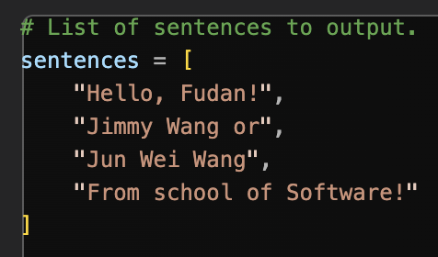
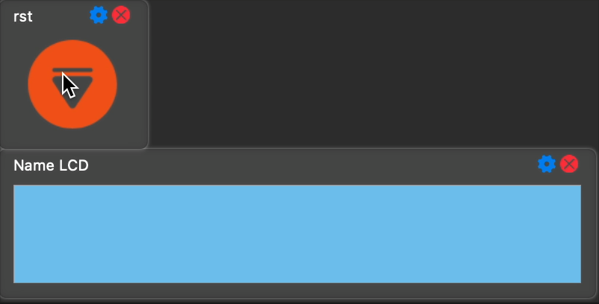
Experiment Results
Script Input
Script input
Rabbit Output
DEMO: Rabbit output results
Notes:
Given the four sentences I want to display, the script generated the corresponding Verilog code & I fed it into DC before going through UFDE workflow and downloading the bitstream onto the FDE board.
The second image shows the result of the experiment.
[2:00]

Slide 6

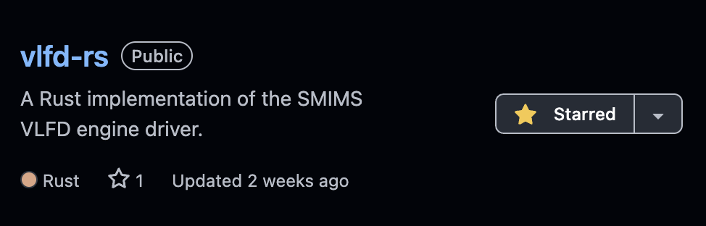
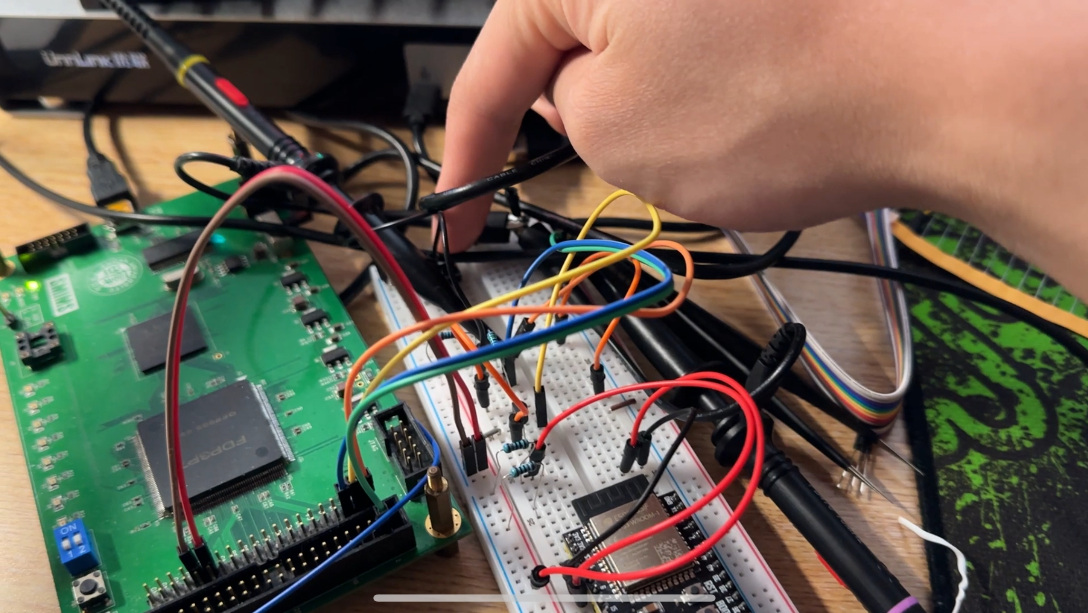
Experiment 2
Main topics
UDFE & Rabbit compiled on MacOS
SMIMS Engine
SMIMS VLFD Driver Reimplemented in Rust
FDE-CLI
I2C
Notes:
Now on to experiment 2.
In the second experiment, I did a few things such as:
Getting UFDE & Rabbit to compile and run on MacOS
Figure how the SMIMS engine worked
Reimplement the SMIMS driver in Rust
Code my own FDE-CLI in Rust based on the newly reimplemented driver
and finally, the hardware part, partially implementing of my I2C project

Slide 7
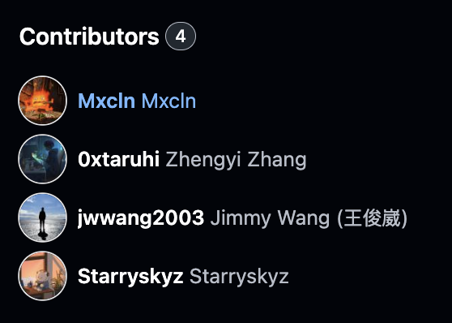
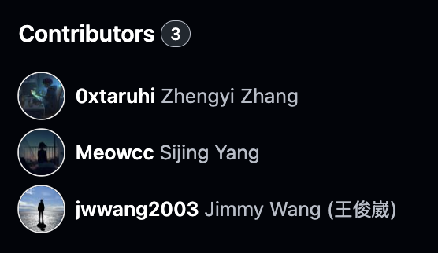
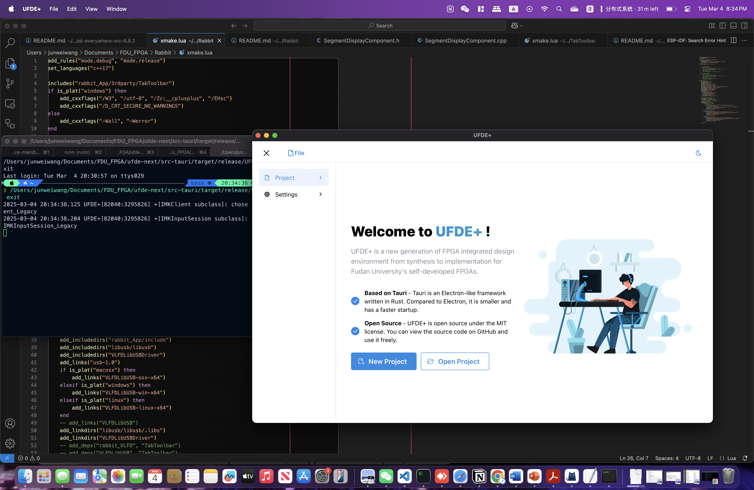
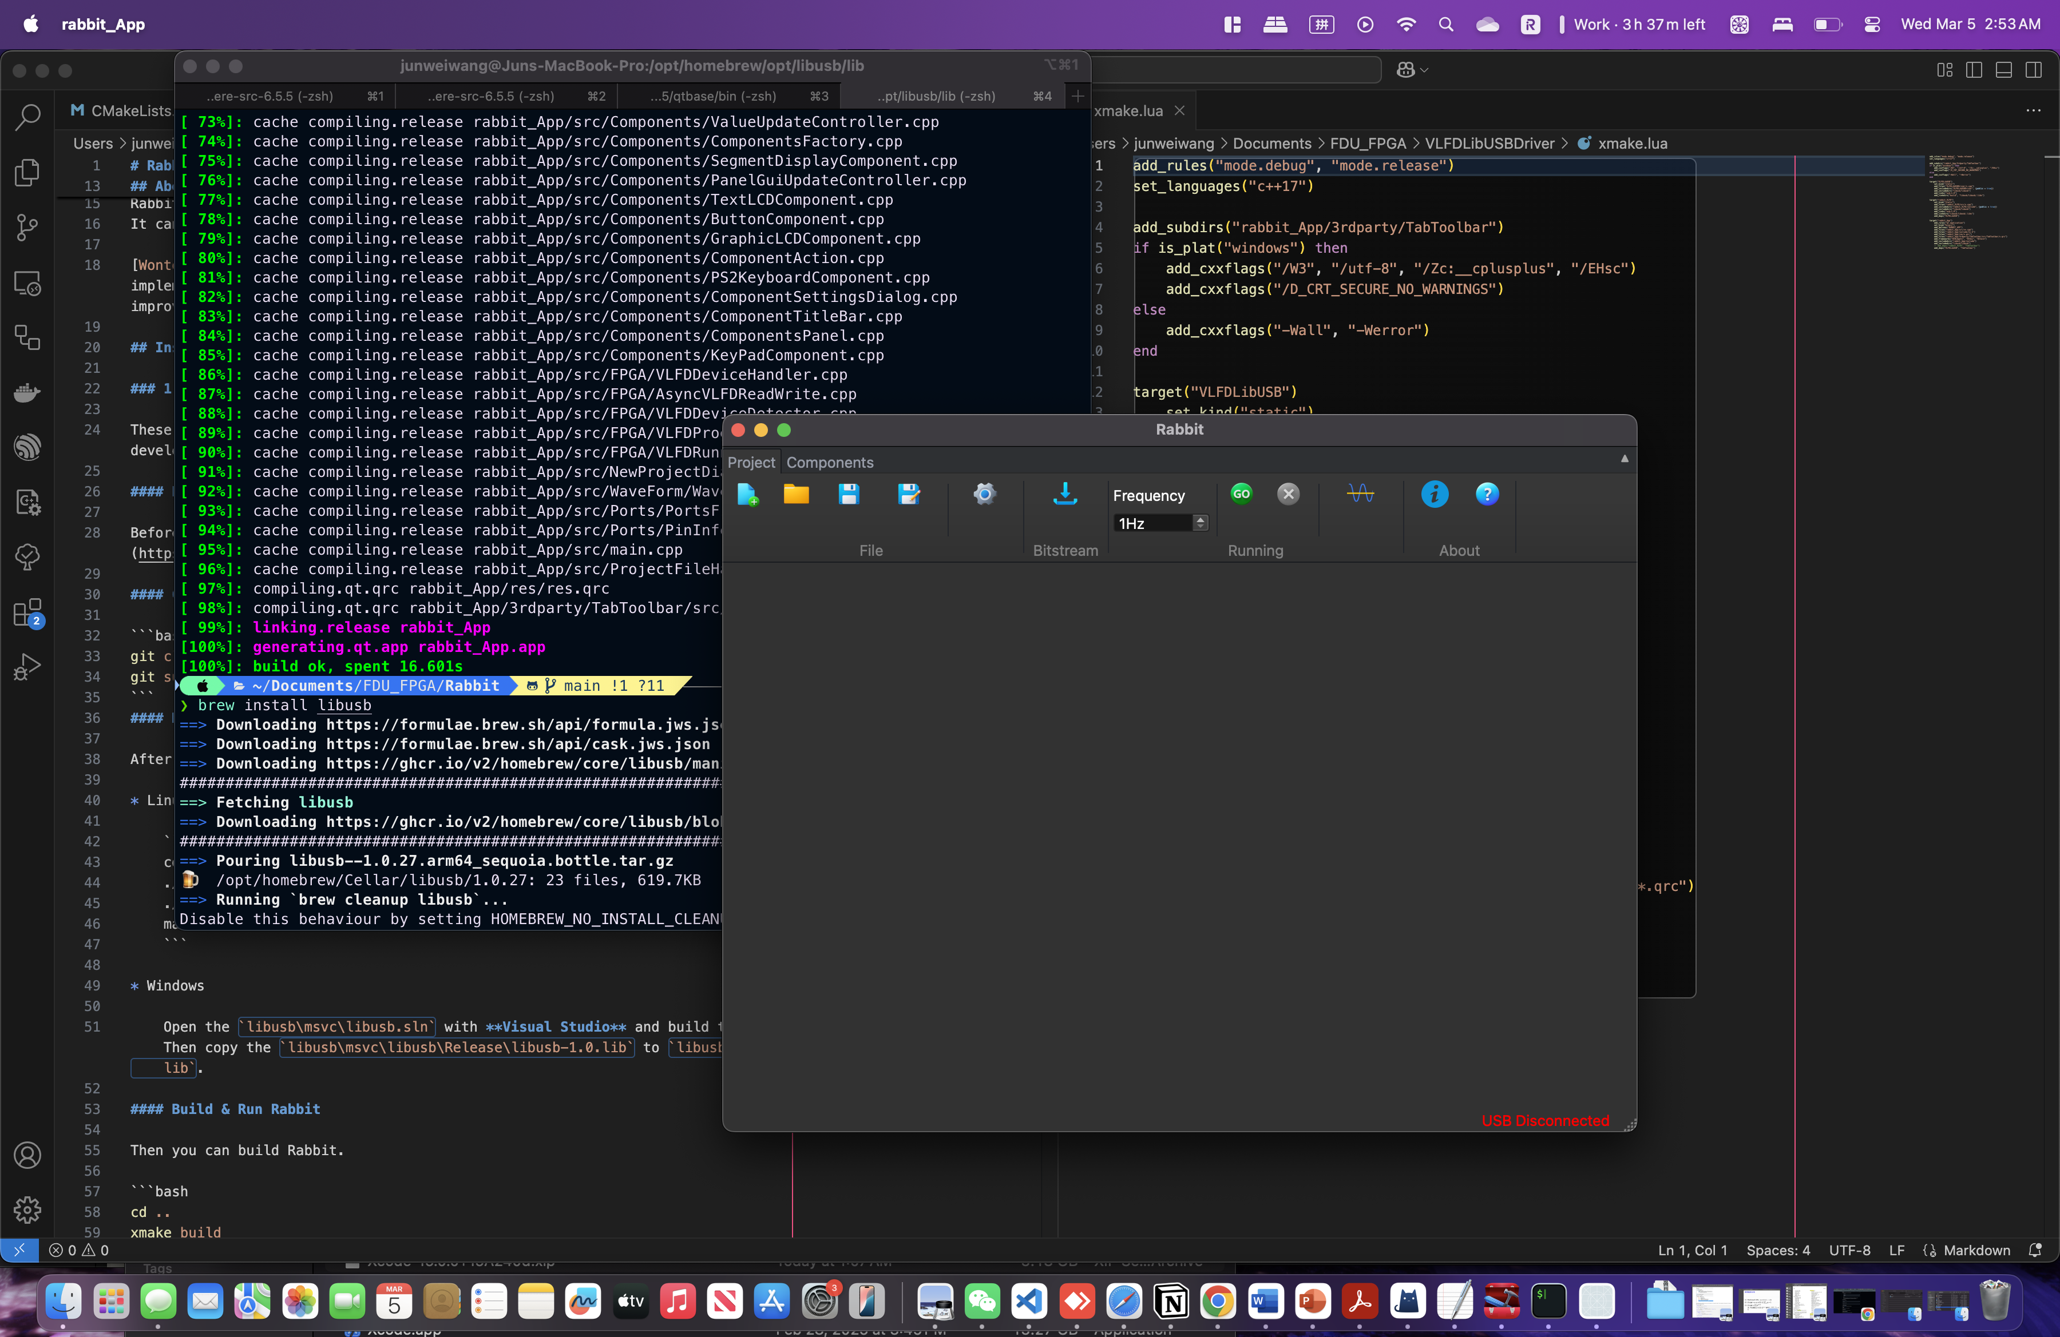
UFDE & Rabbit on MacOS (Arm)
UFDE compiled on MacOS
Rabbit Compiled on MacOS
Notes:
So, as a Mac user, it would be a lot more convenient for me if I can get most of the tools running on MacOS, therefore, I went out of the way to recompile binaries, such as QT & FDE tools, and even going as far as editing a bit of the source code to things running on modern MacOS.
Almost all the demos shown in this presentation are ran on my MacOS.
(of course, the DC synthesis, generating the gate-level Verilog file, I still have to use a Linux environment running on a x86 virtual machine ) UFDE & Rabbit are fully functional, except the bitstream download feature on Rabbit (for some reason it would cause a segmentation fault and is unresolved up to this day)
But I suspect it has something to do with the SMIMS VLFD driver.

Slide 8
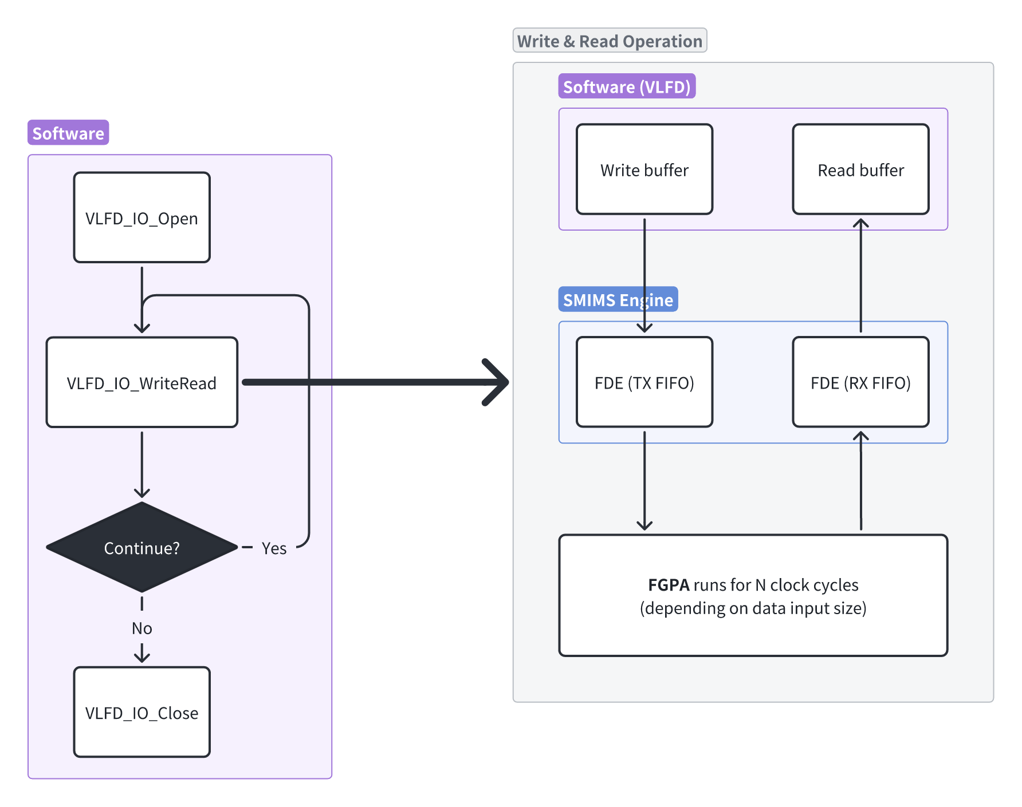
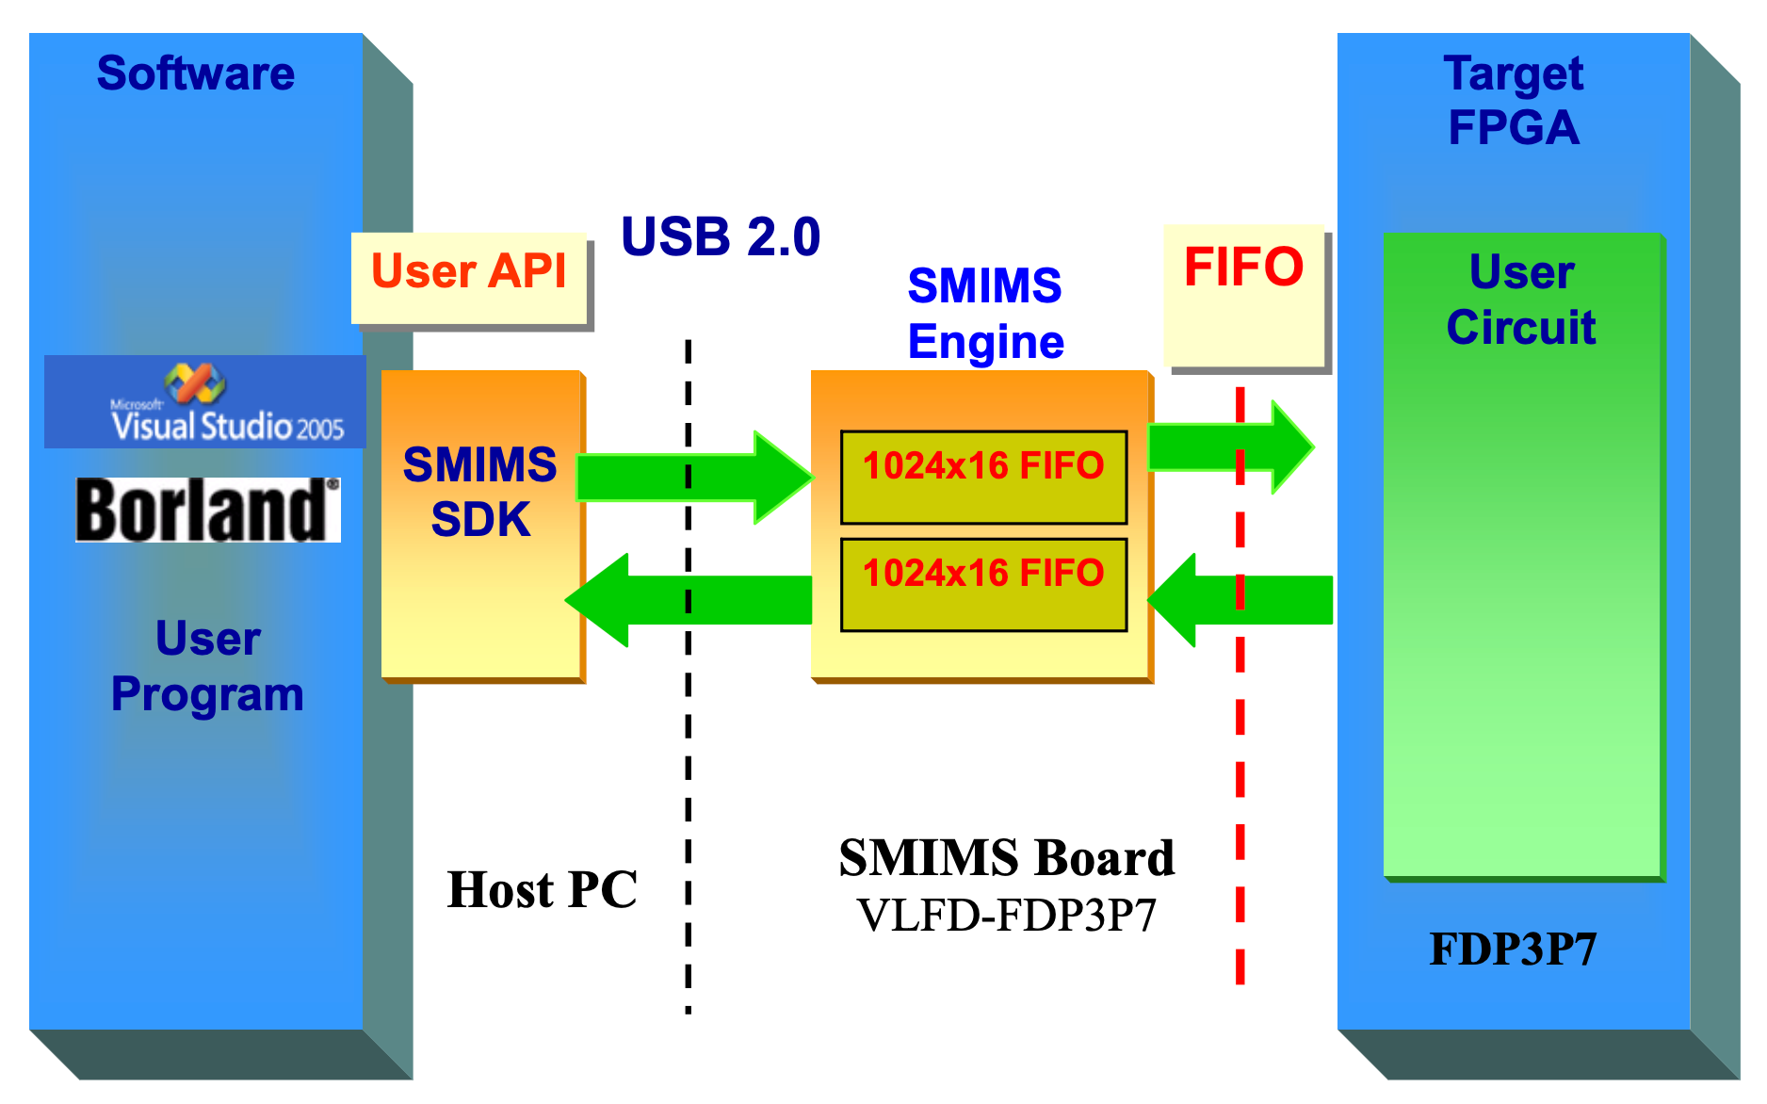
SMIMS Engine
Notes:
Now on to the SMIMS engine part, I will give a little demo on how to interpret the array of bits outputted by Rabbit (namely for the two files RabbitReadData.txt, and RabbitWriteData.txt)
There is also another waveform file. These three files can be found the root directory of your Rabbit project.
Those two text files actually contain the raw bits read from the two FIFOs in the SMIMS engine.
I will address the two FIFOs as, the transmitting (or TX) FIFO and receiving (or RX) FIFO form the viewpoint of the end user.
So, the transmitting FIFO would contain data we write to the SMIMS API, and the receiving FIFO is the data that can be read from the SMIMS API.
There are both 16 bits wide and have 1024 entries. Ill shed some hindsight that each clock cycle requires four entries in the FIFO.
Therefore, if we were to completely populate the FIFO, the SMIMS engine would make the FGPA run for a maximum of 256 cycles.
In the SMIMS driver, there are four main methods that allow us to interact with the FDE board:
IO_Open
IO_WriteRead
IO_Close
IO_ProrgamFPGA (not listed)

Slide 9
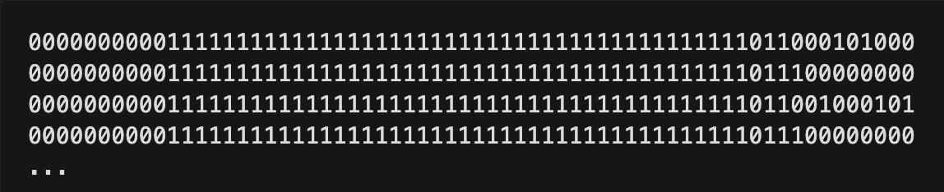
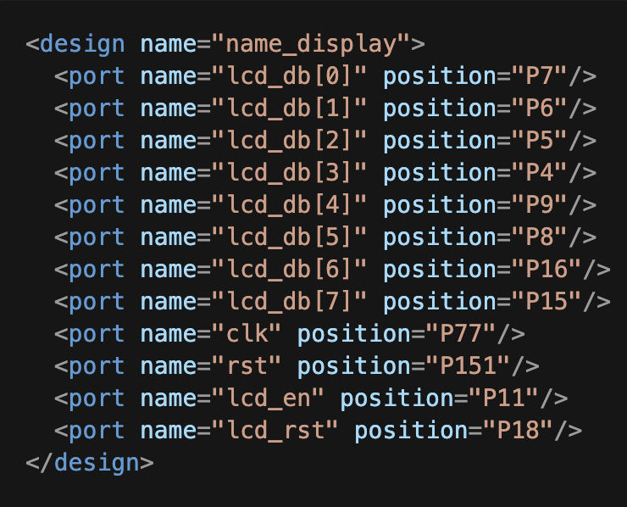
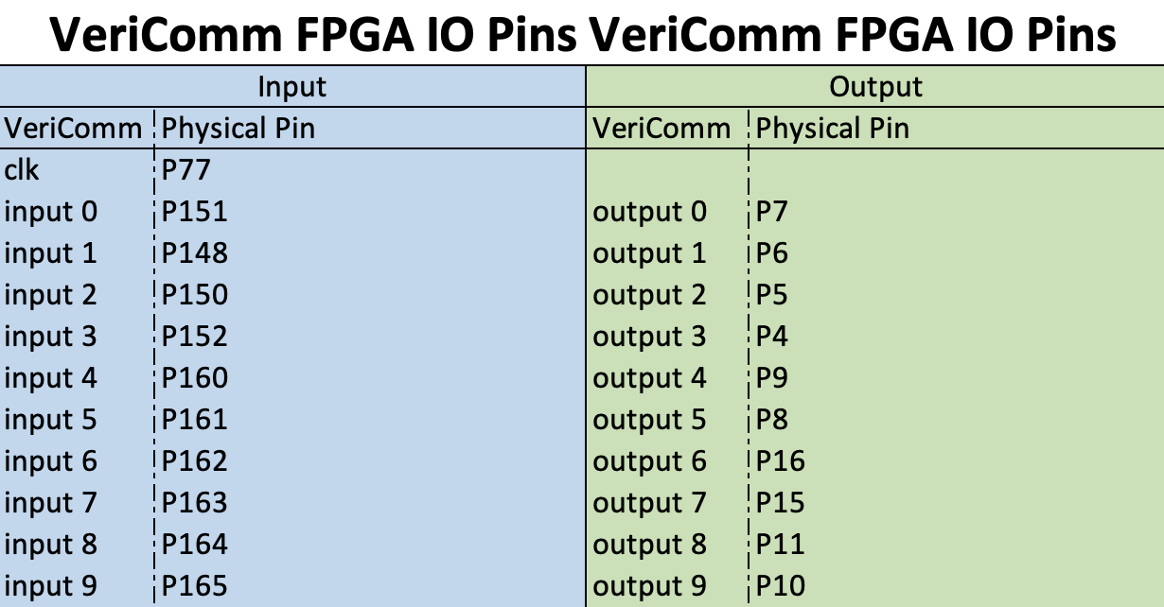
DEMO
Raw data from RabbitReadData.txt
indices mapped to one bit on the data read from the FIFO (little endian)
Mapping spreadsheet
lcd_db[0] ~ lcd_db[7] → output[0] ~ output[7]
rst → input[0]
lcd_rst → output[8]
Constraints .xml file
Notes:
Using the name display experiment as an example, lets try to make out what the stream of bits flowing in and out of the SMIMS engine means.
(I think 64 bits is still used, even those 10 bits are wasted is because of padding and alignment)
On the left-hand side, we have the constraints file for the name display experiment. We can match the position for each port onto the physical pin column in the excel and we can figure out:
Whether it is input or output port
What its index is
The indices behind input or output can be mapped to a bit on the data read from the FIFO.
But note that on the data returned from the IO_WriteRead is in little endian, so its first byte of data starts from the right (or LSB).

Slide 10
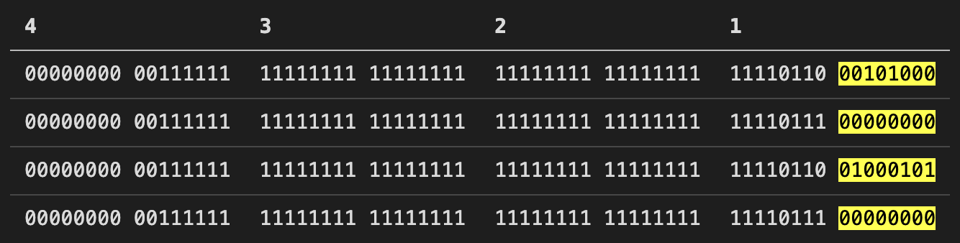
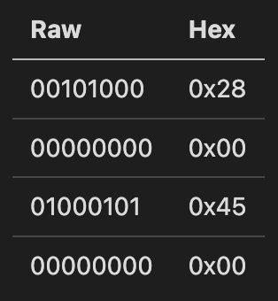
DEMO
Raw data from RabbitReadData.txt
lcd_db[0] ~ lcd_db[7] → output[0] ~ output[7]
rst → input[0]
lcd_rst → output[8]
H
e
…
Notes:
Now armed with the knowledge of the constraint port to VeriComm input output index mappings, we can try to analyze what the array of bits represent.
The bits highlighted in yellow represent lcd_db bus and the chart beside it has the information decoded into its corresponding character.
We can see that the first four samples start to spell out “H” and “e”, which is correct because the name display starts with “Hello, Fudan”

Slide 11
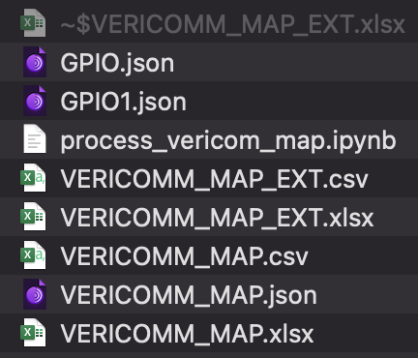
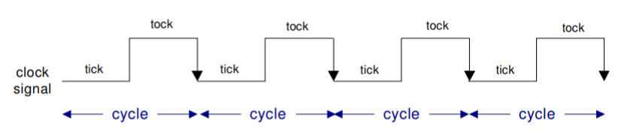
SMIMS Engine Summary
VeriComm ports & GPIO domentation
Has two FIFOs (TX & RX) of size 1024x16
Each set of data is 64 bits long so it takes up four slots in each FIFO
The number of items in the FIFO determines the number of ”tick tocks”
For each entry in the TX FIFO, expect its response from the RX FIFO
Data read from the USB driver is in little-endian format (split into byte chucks, read from rightmost chunk)
Clock signal reference image
Notes:
The main take aways are that the SMIMS engine:
** read the bullet points
I have also documented all the VeriComm ports for the SMIMS engine & the pinouts for the GPIO in a excel file, and wrote some python scripts for them.

Slide 12

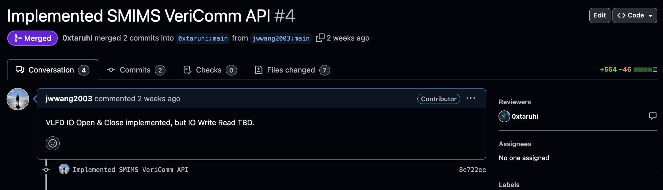
SMIMS VLFD Driver in Rust
GitHub repo for VLFD driver
https://github.com/jwwang2003/vlfd-rs
UFDE PR for VeriComm API
https://github.com/0xtaruhi/ufde-next/pull/4
Notes:
I have also gone through the trouble of finishing the implementation of the Rust SMIMS driver that 张学长 started a while ago.
Before UFDE only had the bitstream download feature, but now with a fully fledged driver with the same features as the C version, UFDE can potentially have the same features as Rabbit with an even better-looking user interface & virtual components.

Slide 13
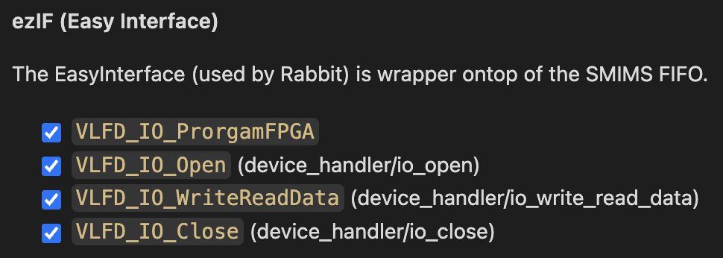
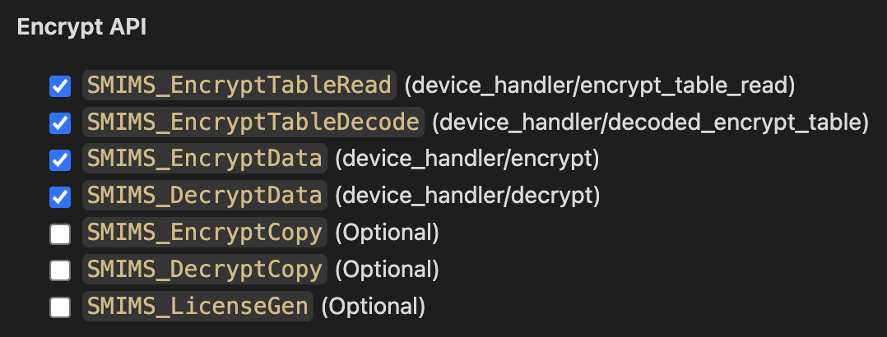
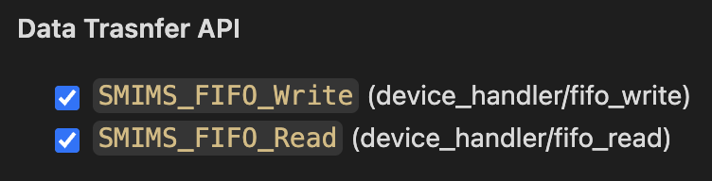
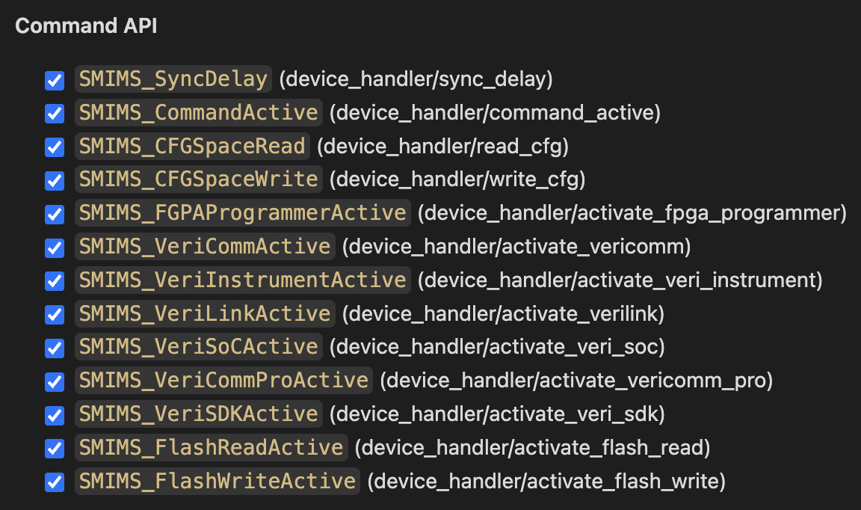
Features
Implementation Check List (ezIF)
Implementation Check List (Transfer API)
Implementation Check List (Encryption API)
and more…
Future Work
Finish implementing LicenceGen & serial functions
Device context (API natively support multi-device)
Handle asynchronous events (device unplug, etc.)
Handle errors (prevent segmentation faults)
Implementation Check List (Command API)
Notes:
Almost of the original features in the C driver have been implemented in Rust. Everything except for the license generation & serial communication which contains methods for the license key check & generation.
I have realized that the serial activation number for all the FDE boards are the same, and the license generation method is actually optional as I can just hard-code the result of the license generation into my code and it would work.
This is bad practice however; in the future I will make sure that these functions are implemented properly.
Aside from that, I also intend to implement proper device context for the libusb library, and handle asynchronous events, such as device unplug.
Currently, if a device is unplugged, sometimes its fine but sometimes a segmentation fault occurs, so there could be some improvements in handling errors.
Now, with a fully functional SMIMS driver implemented in Rust, we can build a lot of things easily because of how comfortable it is to develop with Rust than C++.

Slide 14



C++ vs Rust VS JS
Aspect | C++ | Rust | JavaScript (TypeScript)
Type | Compiled, OOP | Compiled, Systems | Interpreted/Compiled, Dynamic
Memory Management | Manual (pointers) | Ownership model, no GC | Automatic Garbage Collection
Performance | Very High (system-level) | High (performance, safety) | Medium (depends on V8 engine)
Concurrency | Manual threads, parallelism | Safe concurrency (async/await) | Async with event loop
Ease of Learning | Hard | Moderate | Easy (TypeScript improves JS)
Tooling | Excellent (IDE support) | Excellent (Cargo, rustfmt) | Excellent (VS Code, NPM)
Ecosystem | Mature | Growing, strong for systems | Huge (Node.js, NPM)
Use Case | High-performance apps | Systems programming | Web development, Async I/O
Integration in Node.js | Native Addons (node-gyp) | FFI, WebAssembly | Native, main language for Node.js
Asynchronous Support | Manual handling (threads) | Advanced async/await | Native async/await, Promises
Notes:
So all in all, I think Rust is a great programming language. I used to be a hardcore Typescript and NodeJS user, I also coded C++ but most of the time I would avoid it because of how complex things can get sometimes.
It took me around 3~5 days to learn Rust while I was re-implementing the SMIMS driver & I think it offers the best from both worlds:
With Rust, we can enjoy high performance systems programming, on par with C++, but we don’t need to stress about pointers & explicit memory management.
So, memory leaks are basically out of the picture.
Rust also has a package manager for libraries, similar to that of NPM from NodeJS, and I love it.
Compared to C++ which has various types of libraries (static, DLL, system libraries, etc.), It is much easier to ensure system cross-compatibility with Rust.
The ownership model was a bit of a learning curve but if you are familiar with pointers, you would quickly realize that its actually quite intuitive.
I also realized that if your Rust program compiles without errors, then most likely its going to function correctly, or at least without memory bugs or leaks. So, all in all, I think Rust is a great programming language to learn and I learned a lot of it while implementing the SMIMS driver and my FDE-CLI.

Slide 15
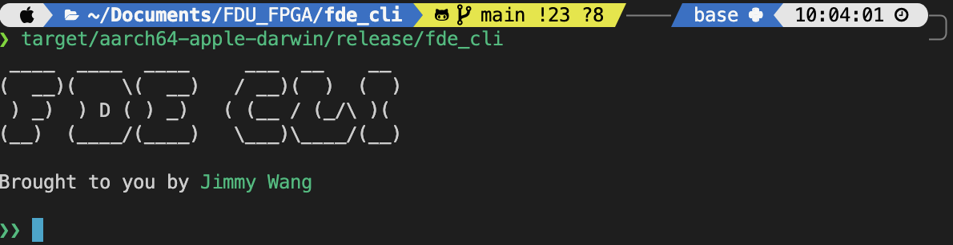
FDE-CLI
Features
Aims to offer a “GDB like” debugging experience
Manage multiple FDE boards
Debug SMIMS engine
Manage project files
Downloading bitstream & fine grain control over SMIMS engine FIFO
Almost everything Rabbit has to offer, except virtual components & GUI
Screenshot of FDE-CLI
Notes:
Next, I introduce to you the FDE command line interface! (or FDE-CLI for short), also implemented in Rust.
Actually, its not a CLI yet, right now its more like my own shell interface for debugging the FDE board.
It:
Aims to offer a “GDB like” debugging experience
Manage multiple FDE boards
Debug SMIMS engine
Manage project files
Downloading bitstream & fine grain control over SMIMS engine FIFO
Almost everything Rabbit has to offer, except virtual components & GUI

Slide 16
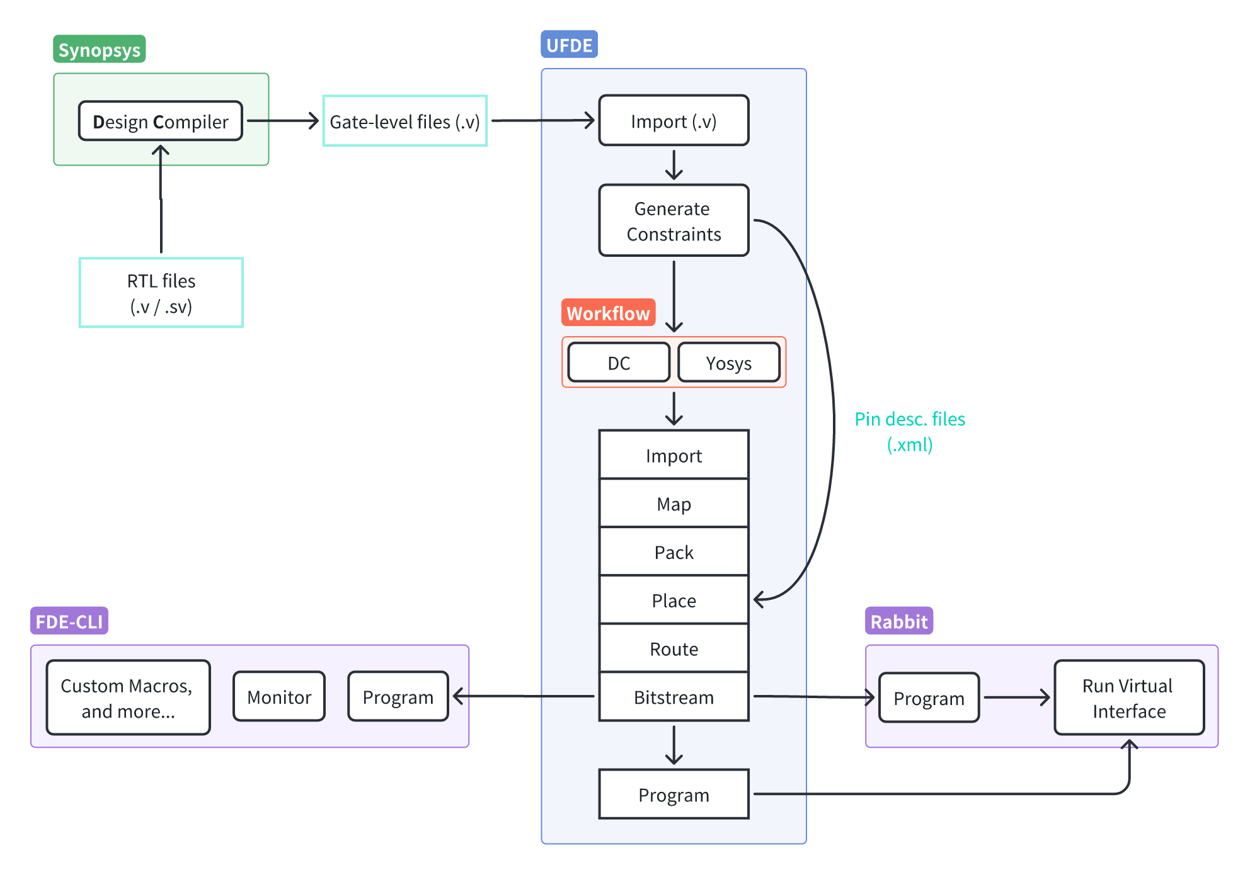
Limitations of Rabbit
Poor cross-platform compatibility
Virtual components on Rabbit are limited
No “fine-grain” control over IO on Rabbit
Not scriptable
What FDE-CLI offers?
Better cross-platform compatibility
SMIMS driver natively in Rust
More versatility in terms of the processing of IO data from SMIMS’s FIFO
Fine grain control over the data sent & read
Scripting
FDE Workflow
Notes:
One of the reasons why FDE-CLI was developed was because of the some of the short-comings of Rabbit namely of its:
Poor cross-platform compatibility
No “fine-grain” control over IO on Rabbit
Not scriptable
FDE-CLI hopes to offer:
Better cross-platform compatibility
More versatility in terms of the processing of IO data from SMIMS’s FIFO
So, fine grain control over the data sent & read
And scripting
FDE-CLI is meant as an alternative for Rabbit or UFDE, so in the future students can choose whether to have a nice-looking user interface on the UFDE,
Or if they prefer using a shell terminal, or a CLI, for debugging & perhaps integrating into their own code, then they could also go for my FDE-CLI.

Slide 17
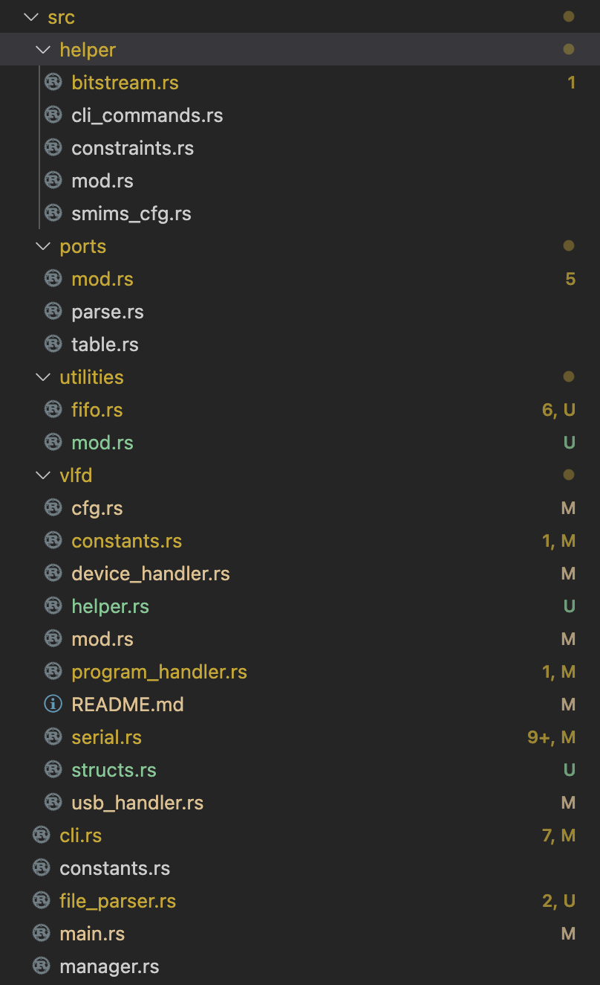
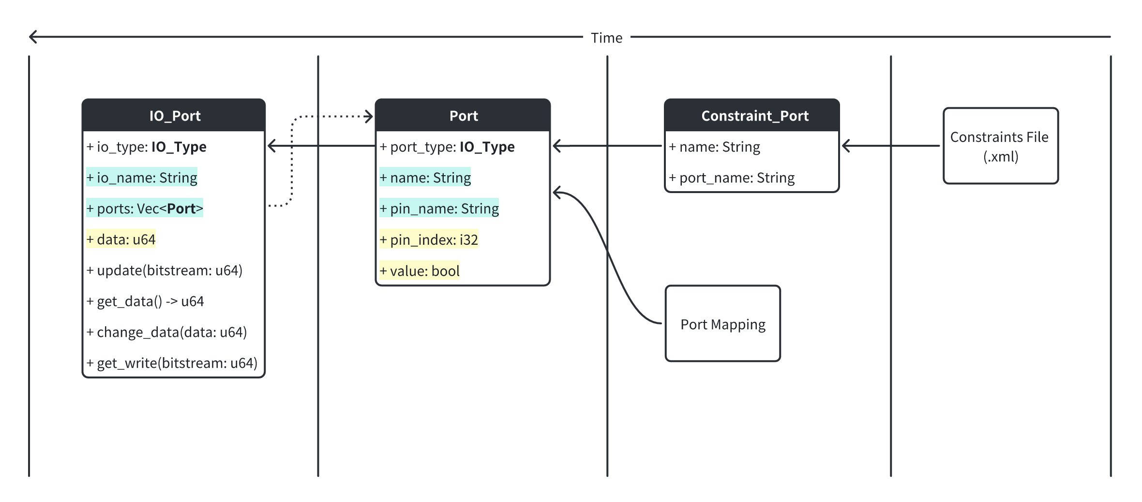
FDE-CLI Structure
IOPort & Port structs & implementations
FDE-CLI folder structure
Notes:
Here is a rough structure of my FDE-CLI implementation, its still in the making so things are subject to change.
The VLFD folder contains the SMIMS driver.
The ports folder contains the implementations necessary to parse and create virtual IO ports based on the constraints file.
The helper folder contains some small methods that is necessary for the basic functions of the CLI.
And I have a little UML diagram of the IO_Ports implementation here.
In the future, there would be better documentation in the README of this project’s GitHub repository.

Slide 18
FDE-CLI DEMO
Notes:
Now I will show a few demos of the some of the features I implemented in FDE-CLI

Slide 19
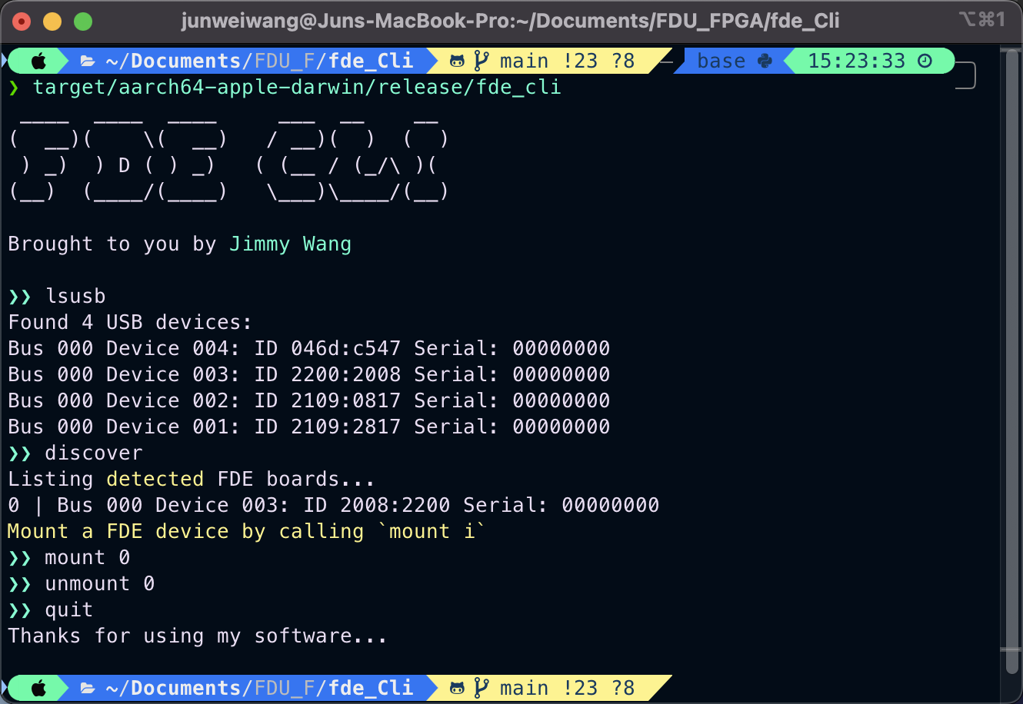
Discovery
FDE board discovery
FDE-CLI can recognize & differentiate multiple FDE boards
Each detected FDE board can be indexed (0~n boards connected)
We can “mount” or “unmount” the FDE board(s)
Notes:
** Read points first
We can also program & run multiple FDE boards at the same time

Slide 20
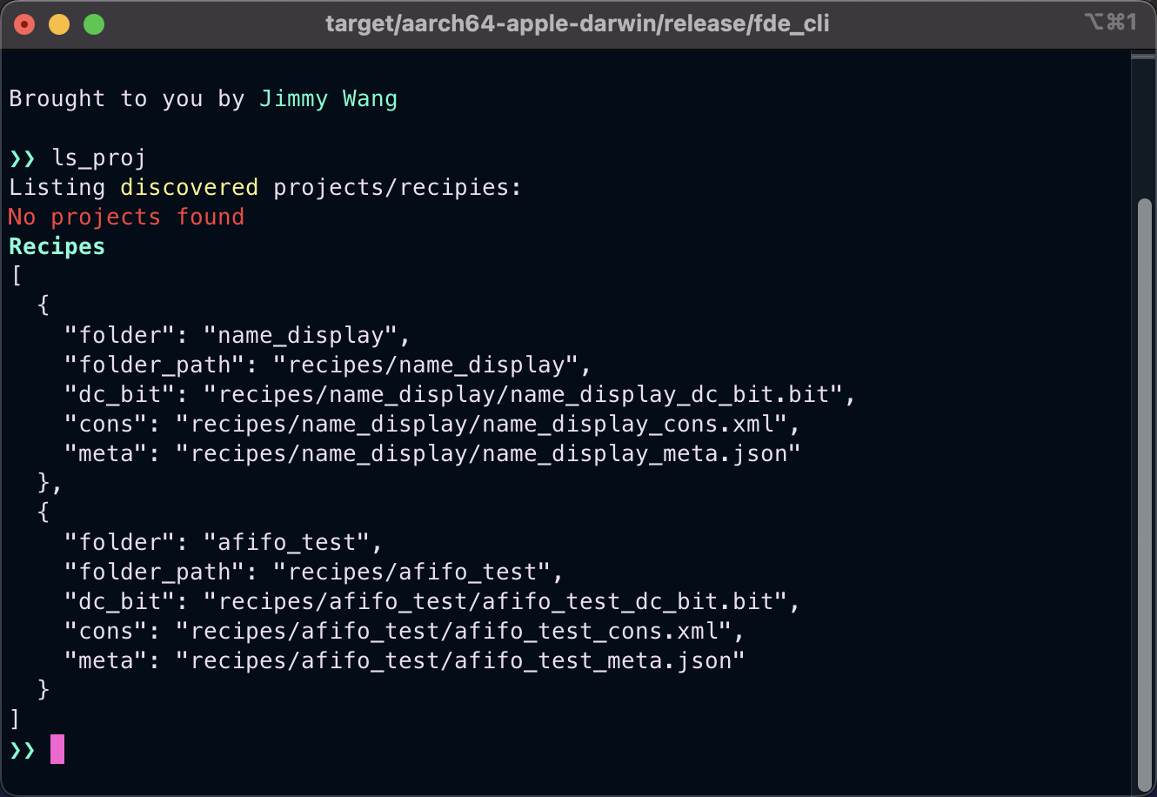
Projects & Recipes
Similar to UFDE & Rabbit
FDE-CLI has its own project management system
Projects refer to user imported projects
Recipes are built in project demos
In the future, projects/recipes can also have scripts in them

Slide 21
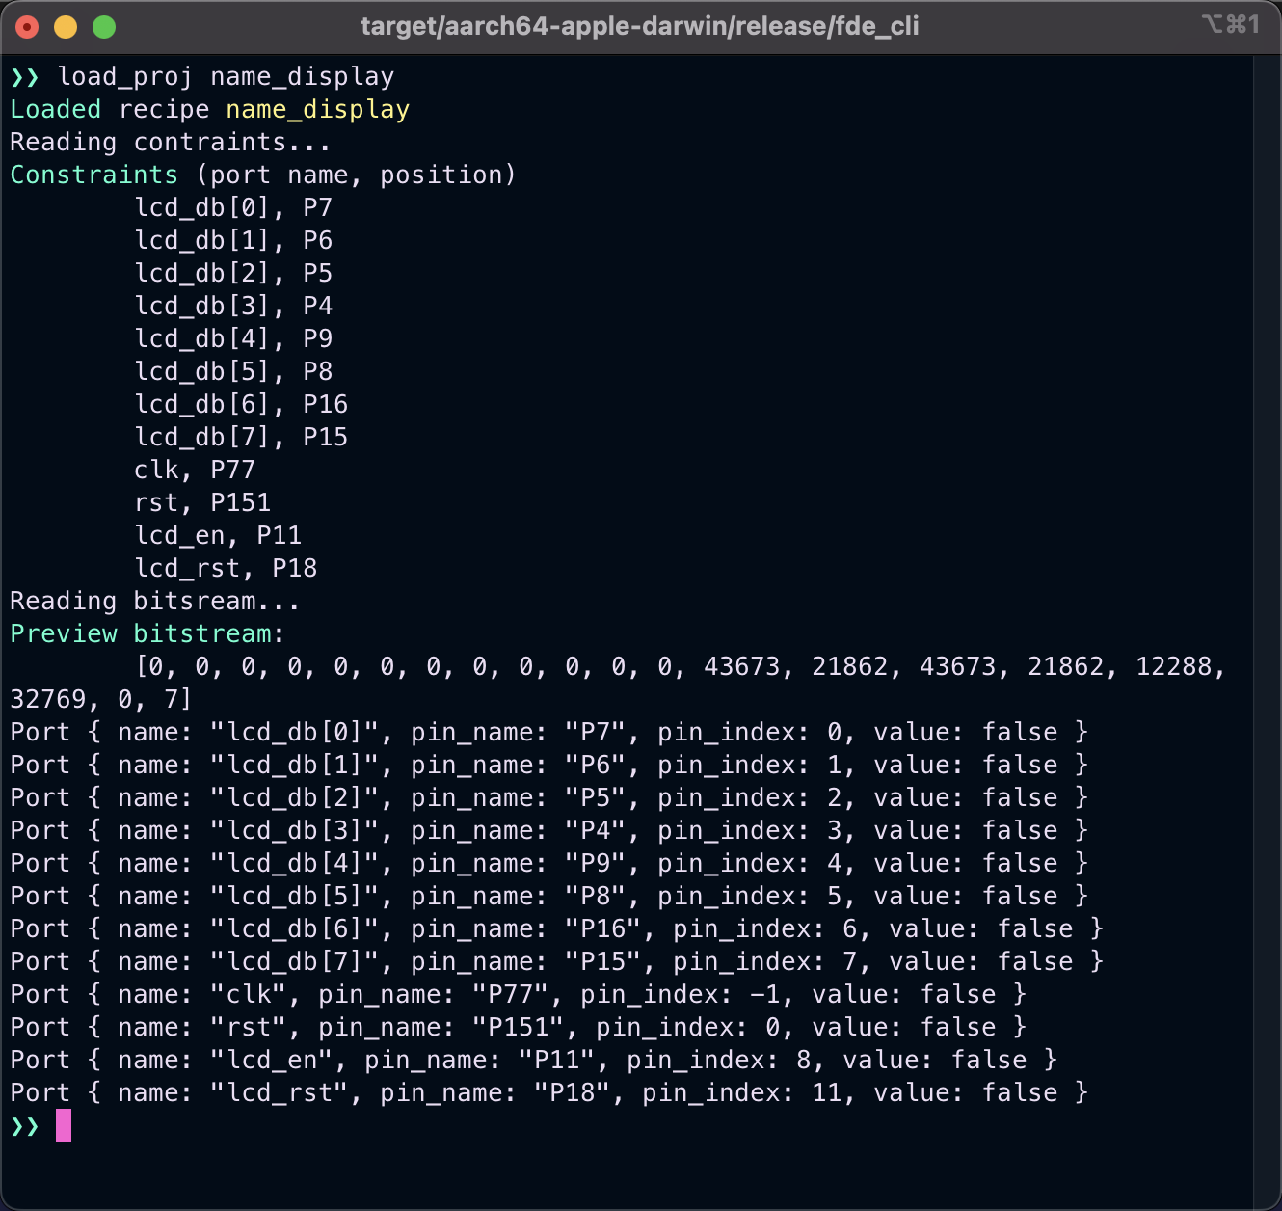
Loading a Project/Recipe
Interpreting constraints & detecting IO ports
FDE-CLI can parse and interpret constraint files & bitstreams
FDE-CLI has a regex mechanism that detects whether an IO port is a single data line or is part of an array
Useful later when observing how data changes

Slide 22
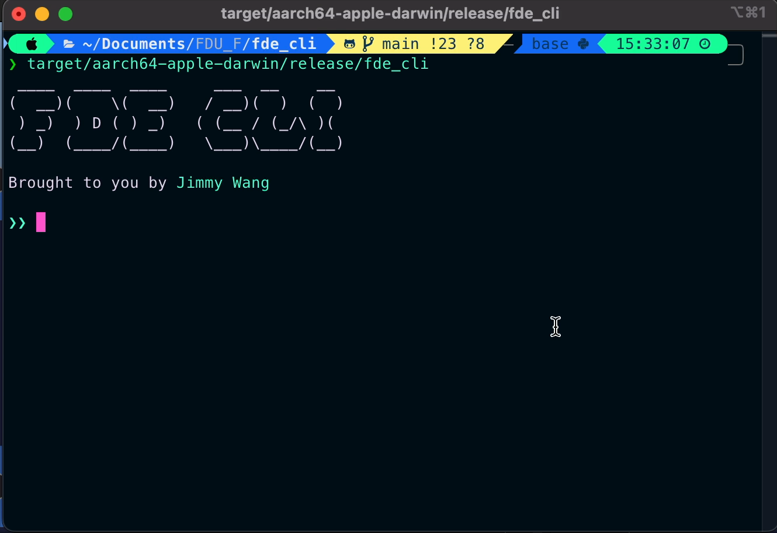
FDE-CLI DEMO Name Display
Objective
FDE device discovery
Loading a project/recipe
Programming a FDE board
Running for 4 cycles & printing the output

Slide 23
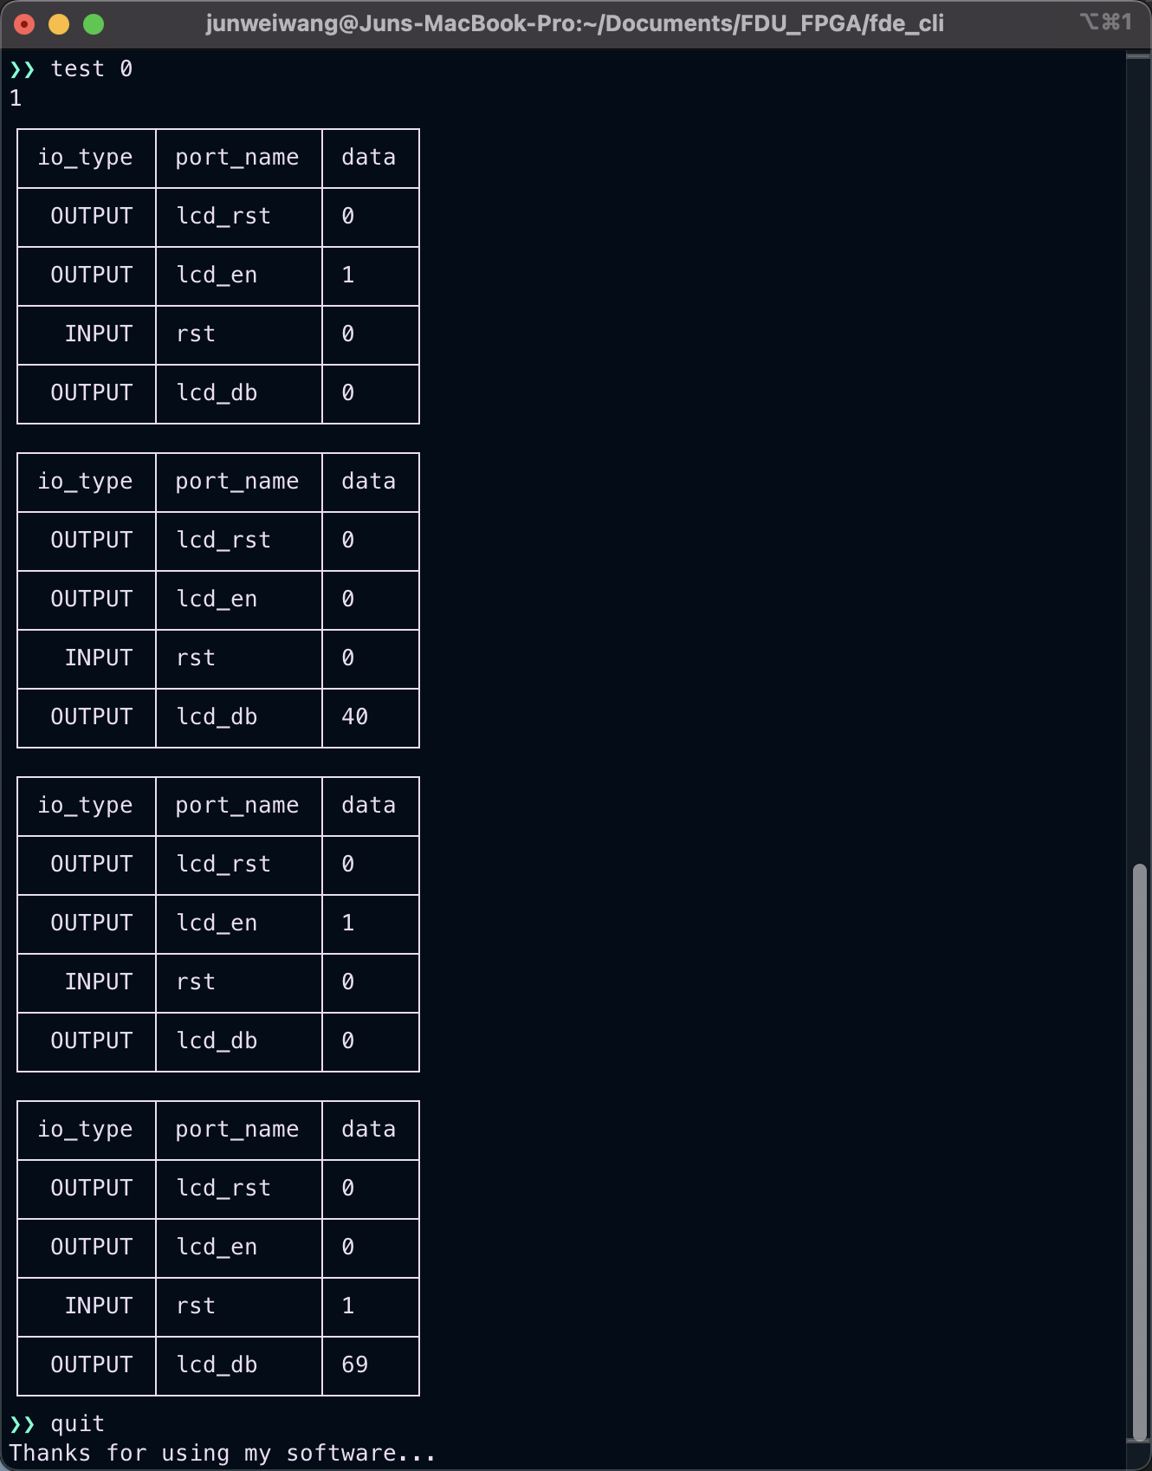
FDE-CLI DEMO Name Display
Explanation
40 = 0x20 (H)
Each table is the resulting IO state of each clock cycle
Notice how in these four clock cycles, we see “H” and ”e” being outputted on the data bus
We can expect to see “llo” if we run for 6 more cycles
69 = 0x45 (e)
Snapshot of output of the output of name display FDE CLI demo

Slide 24

FDE-CLI Future Plans
Future to-do:
Multi-threading (to interact with multiple FDE boards at the same time)
Multi-threading to support polling data from a AFIFO
Support scripts (similar to DC’s .tcl file)
Better error handling
Handle asynchronous events (s.a. USB unplug)
…

Slide 25
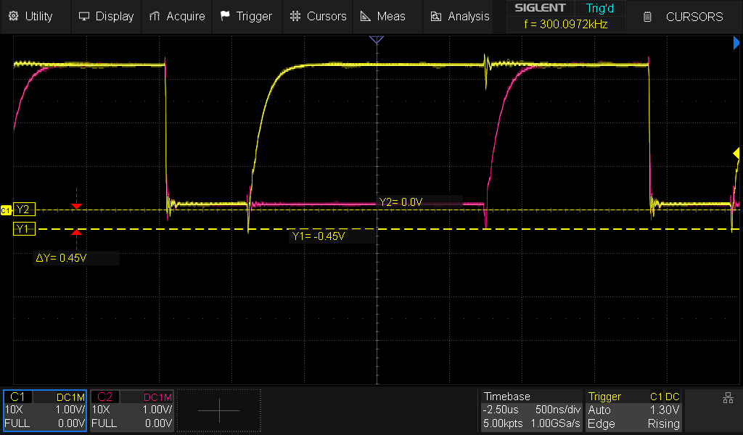
I2C
(Inter-Integrated Circuit)

Slide 26
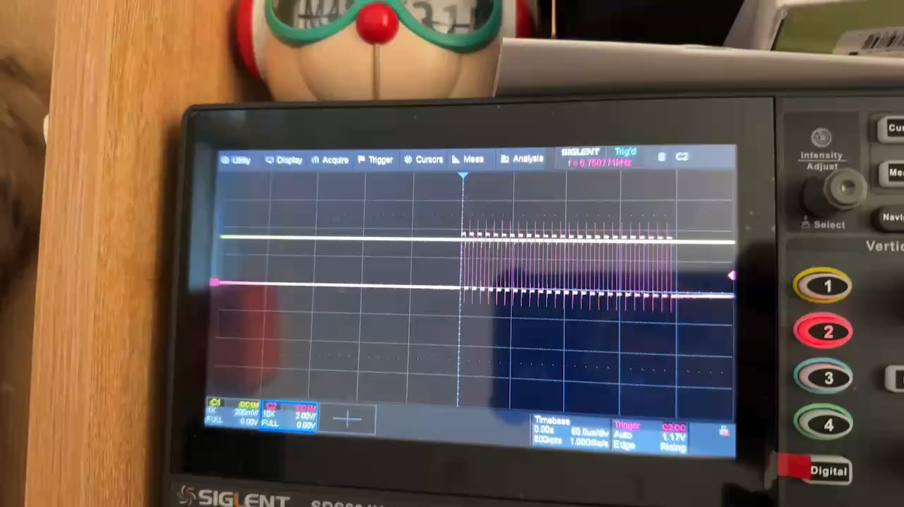
Growing Pains
Timing Issues
Video of jitters observed from the SMIMS clock at high frequencies
Qt::PreciseTimer & thread::sleep (Rust) suffer from precision issues
At high frequencies, we might observer jitters (fluctuations in timing)
Windows/MacOS is definitely not a real-time operating system (RTOS), and most Linux machines aren't either
Rabbit
Rabbit does not have any virtual component(s) for reading & writing (hex/binary data) to and from registers
No fine-control over the processing of data received & transmitted on every clock cycle
No scripting / automation
Notes:
During the implementation of my I2C module, I have met some issues such as timing issues and being unable to have fine-control over the data processing and data being transmitted between Rabbit and the SMIMS FIFO.
In the video clip, the bursty look of the signal can probably be attributed to:
The USB driver sending data in bulk
SMIMS engine reading from the FIFO in bulk
Or both
This led to inconsistencies in the signals being generated.
Because Windows & MacOS are not RTOS, if the frequency is too high, we should not trust that the SMIMS clock is actually running at the defined frequency in equal intervals. Maybe the average clock rate is correct, but from my observations, they are definitely not equally spaced out.

Slide 27
Solution
FDE board has two clocks
SMIMS engine clock (P77)
Internal 30MHz clock (P185)
Have I2C running on the 30MHz oscillator
Use an asynchronous FIFO between I2C module & SMIMS engine
Software
To accurately interact with my I2C module using AFIFOs, I need to build my own program to write & read from SMIMS engine FIFO
Hence, the need for FDE-CLI
Notes:
The solution is to use both clocks on the FDE board.
There is a virtual clock generated by the SMIMS engine and an internal 30MHz clock. The idea is to have the i2C running on from the 30Mhz clock and use an AFIFO to exchange data between the I2C module & the SMIMS engine.
On the software side, to accurately interact with my I2C module using AFIFOs, I need to build my own program that can write & read from SMIMS engine FIFO
Hence, the need for FDE-CLI…

Slide 28
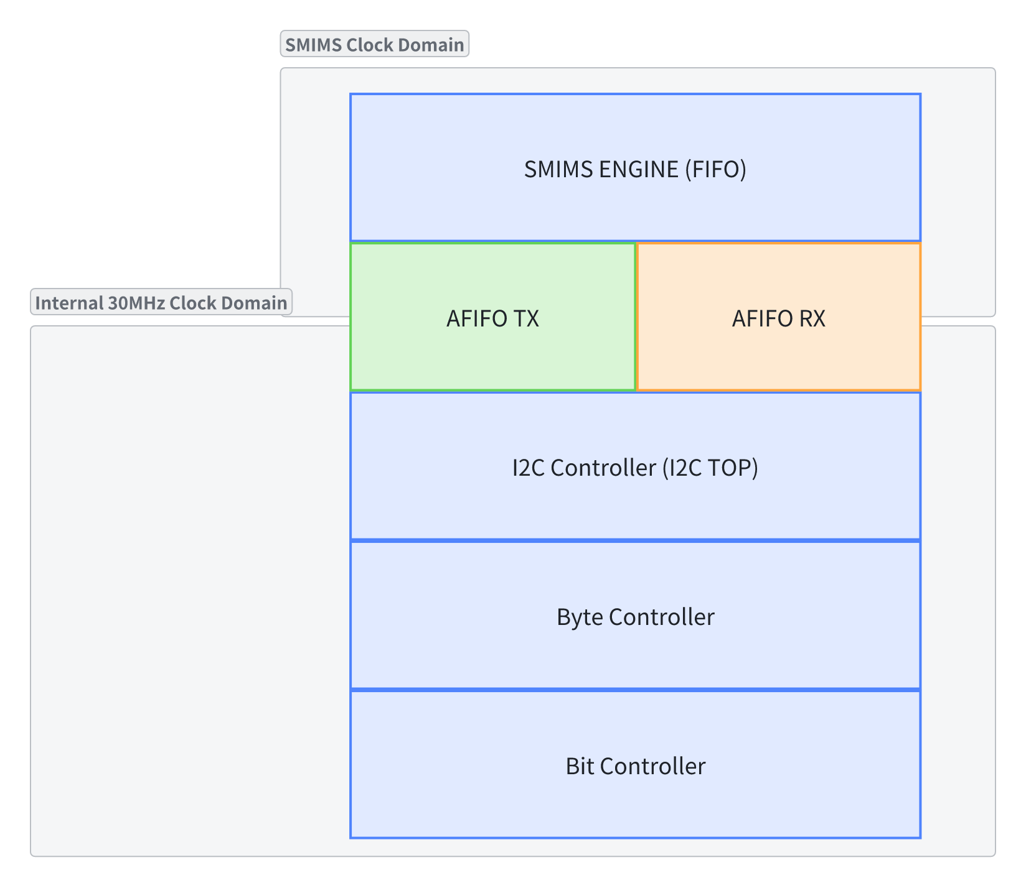
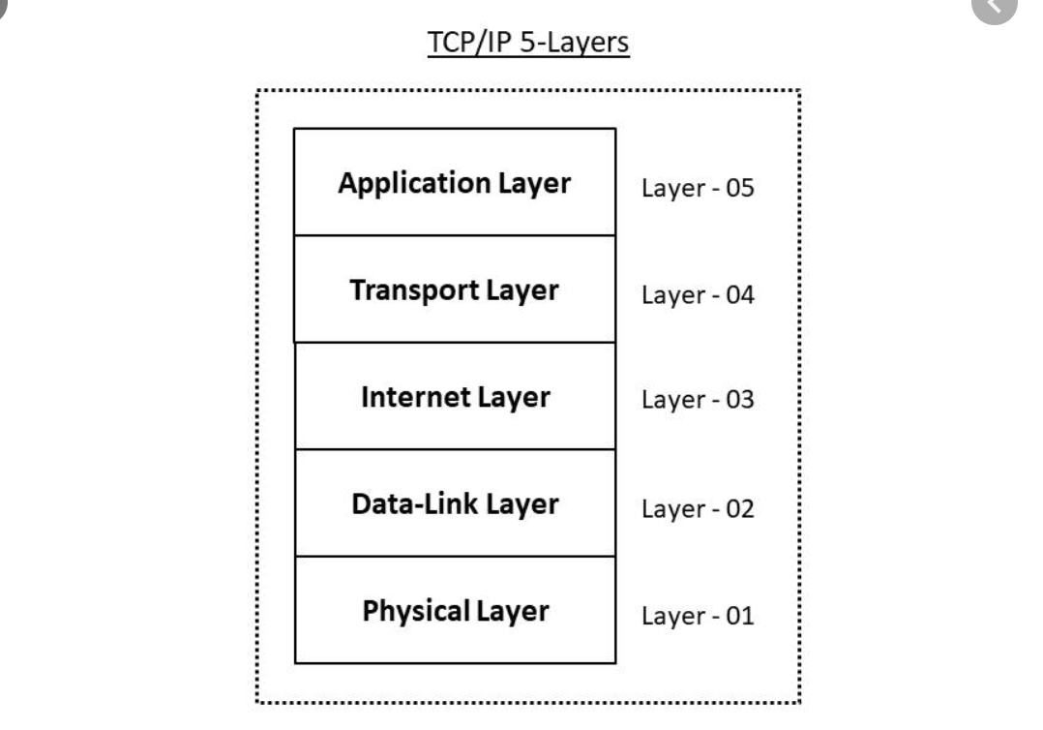
I2C Module Topology
The 5-layer networking model
The proposed topology for my I2C module
Notes:
For my module topology, its actually quite similar to the 5-layer networking approach where each layer abstracts on top of the other.
Three levels of abstraction (excluding the AFIFO):
Top Module (I2C Controller): High-level abstraction of the byte controller (for easy interfacing).
Byte Controller: Manages byte-level data operations and drives the bit controller to send all the bits in each byte.
Bit Controller: Low-level bus control handling SDA & SCL transitions, operating as the physical/data-link layer of the networking model.
Because of the time constraint and I got quite sick the past week, the I2C controller & byte controller is not done yet unfortunately.
Only the AFIFO & bit controller is finished so I will explain and demo them this time. I’ll save the full finished project & maybe other interesting things for my final project.

Slide 29
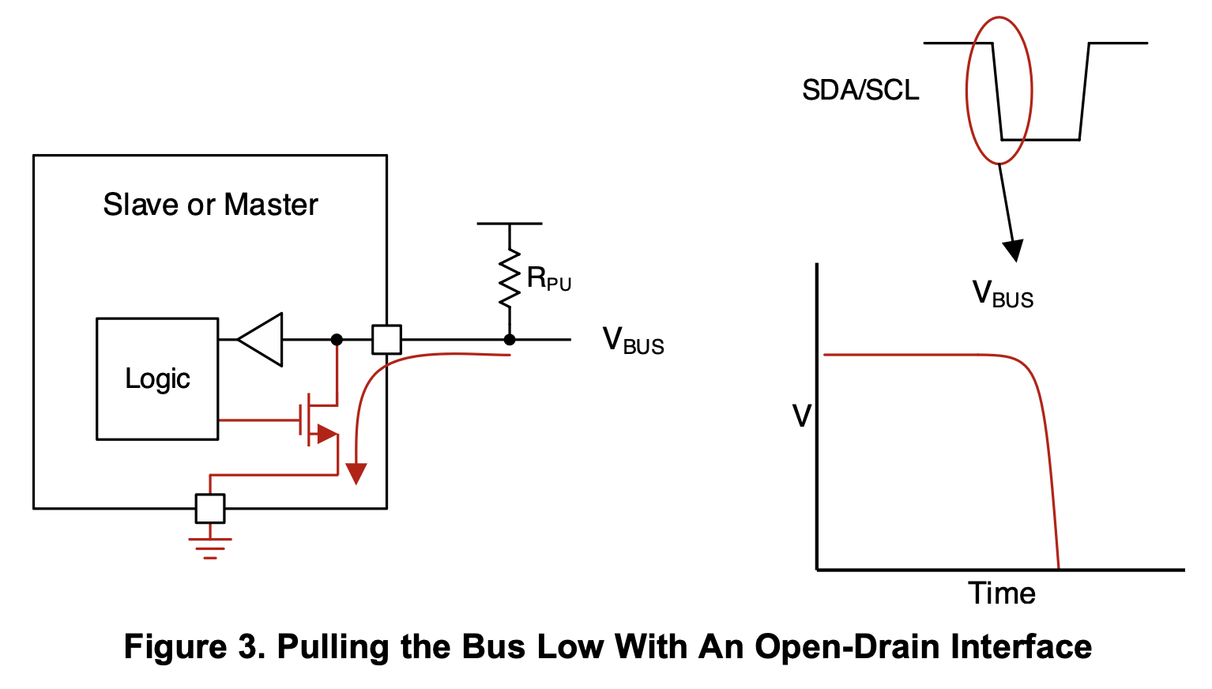
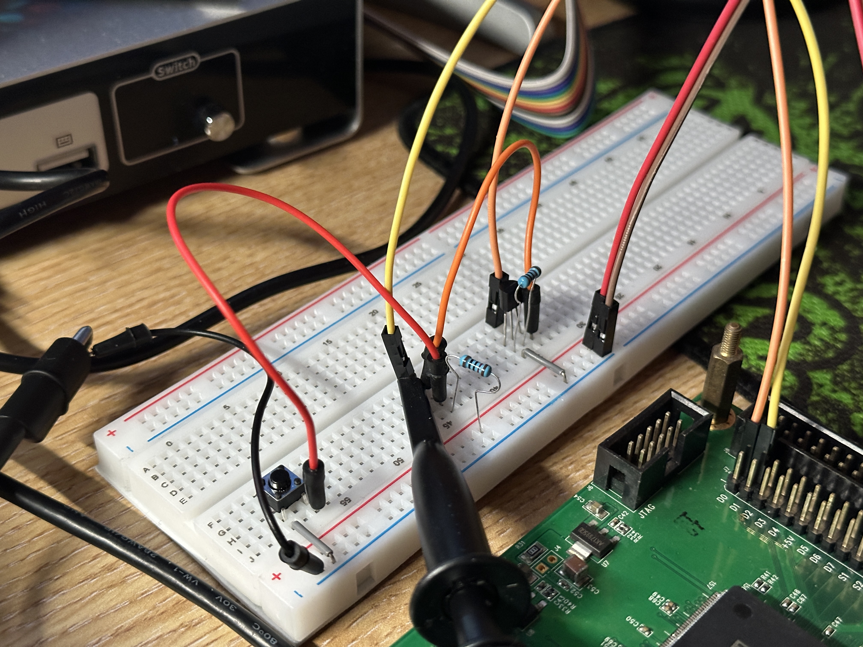
I2C Open-drain
Open-Drain Configuration
TI documentation of open-drain I2C configuration
N-channel MOSFET: This configuration uses an N-channel MOSFET to drive the SDA/SCL lines.
When the MOSFET is off the signal line is left "floating" and is pulled high by the pull-up resistor, representing logic HIGH.
When the MOSFET is on, the signal is pulled low (GND), representing logic LOW.
Based on 2N7000 N-channel MOSFET
An open-drain configuration implemented on a breadboard
Notes:
My I2C implementation uses the open-drain configuration as specified in the Texas Instruments I2C documentation.
The open-drain configuration is implemented using an external N-channel MOSFET because the FDE FPGA does not have any tri-state buffers or (TBUF).
** Read the first two points

Slide 30
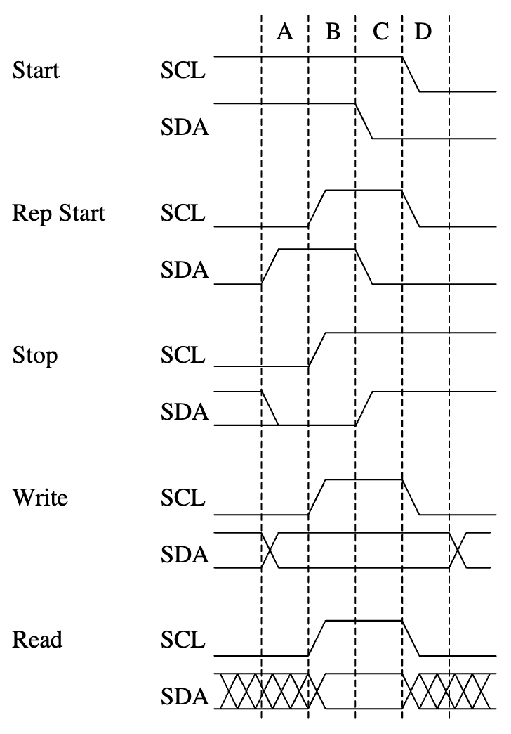
Bit Controller
Bit Controller Responsibilities
Handles raw signal interpretation and bus control
Deals with Start/Stop conditions, ACK/NACK signals
Filters, manages clock skew, and handles arbitration
Comprises of the bit controller module itself & two tri-state buffer modules (for SDA & SCL)
SDA & SCL signal transitions for the 5 conditions
Notes:
The bit controller in my I2C module is comprised of itself, and a tri-state buffer module. Together, they have the following responsibilities:
They handle raw signal interpretation and bus control
They deal with start / stop conditions
They filter, manage clock skew, and handle arbitration
In I2C communication, the START condition is used to signal the beginning of a data transfer.
This is followed by the Repeated START condition, which allows the communication to continue without releasing control of the bus, especially useful for multi-byte or multi-command transmissions.
Finally, the STOP condition indicates the end of the communication, signaling that the bus is now free for other devices to use.
The bit controller is especially critical as it translates the byte-level operations into actual signal transitions on the bus, ensuring proper synchronization of data transfer. It also handles important tasks like signal filtering, clock skewing, and arbitration during bus access.

Slide 31
Bit Controller
Filters, Clock Skew, and Arbitration in the I2C Bit Command Controller
Filters: Ensures clean, noise-free signal transitions
Clock Skew Management: Synchronizes clock signals between masters to ensure accurate data transfer
Arbitration Handling: Resolves bus conflicts in multi-master setups, preventing data corruption
Notes:
In multi-master I2C systems, it is crucial to handle the signals correctly to avoid data corruption and ensure smooth communication between devices.
First, filters clean the signals on the SDA and SCL lines, ensuring they remain stable and free from noise or glitches.
This is usually accomplished by super sampling and then using a voting system to decide on whether the signal is high or low.
Next, clock skew management becomes vital when multiple devices are trying to control the clock.
By synchronizing the clock signals, we ensure that all devices remain in sync with each other, even when some may attempt to drive the lines in opposing directions.
This synchronization is essential for proper data transfer.
Lastly, arbitration handling resolves conflicts when multiple devices try to control the bus simultaneously.
If arbitration is lost, the system resets the operation to prevent any corrupted data transmission.
The arbitration process ensures that only one master controls the bus at a time, making the communication reliable and conflict-free.

Slide 32
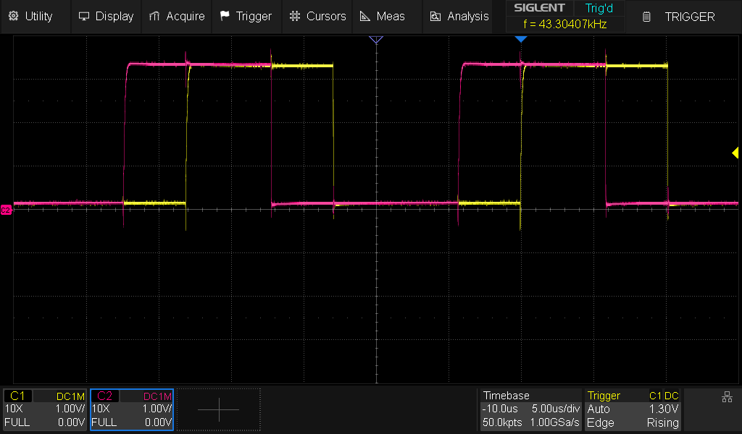
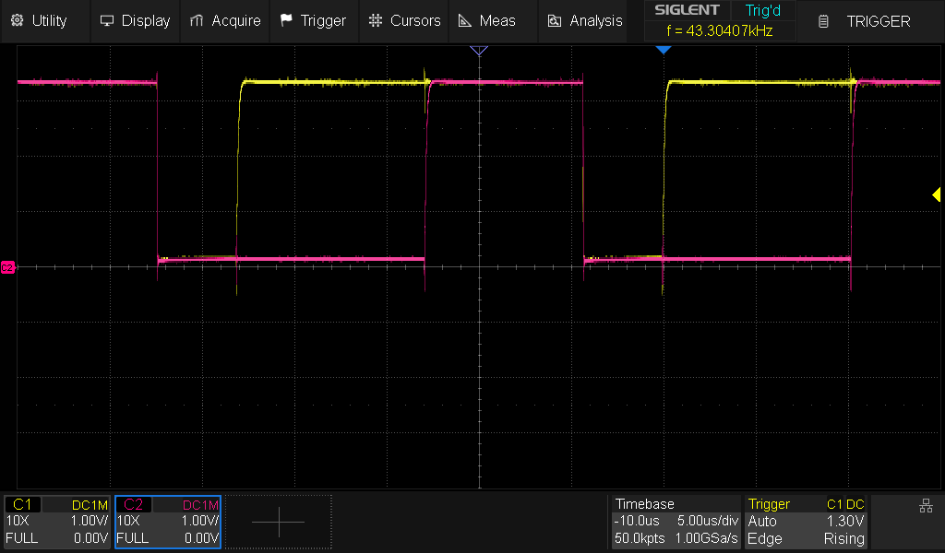
I2C DEMO BIT CONTROLLER
Bit controller: start command
Bit controller: stop command
Notes:
Here is a demo of the bit controller handling the various conditions. The yellow signal presents the clock and the pink presents the data line. Because only the bit controller module is functional at this time, my demo just makes bit controller repeat the same command over and over again.
On the left side, we see the bit controller performing a start command (or repeated start command)
On the right side, we the bit controller performing a stop command

Slide 33
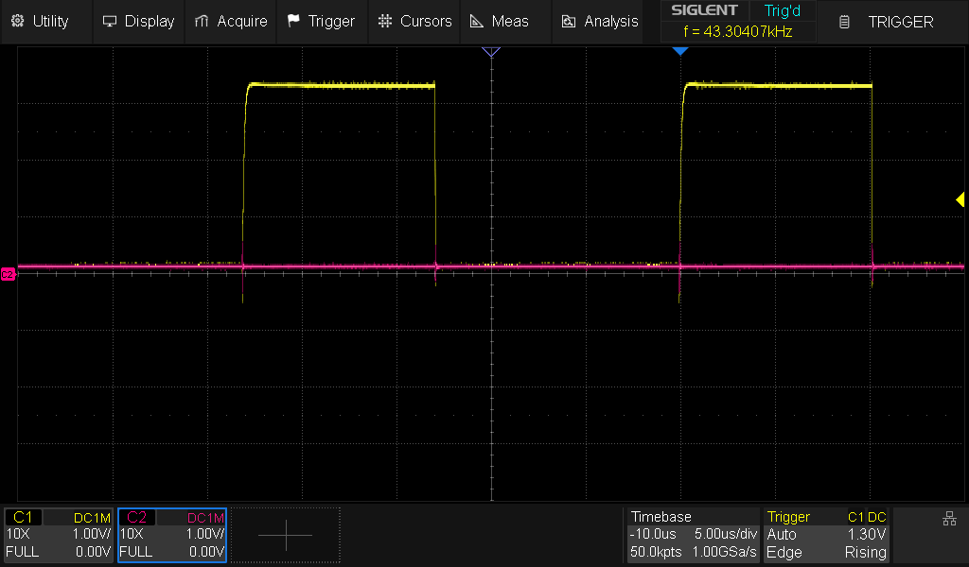
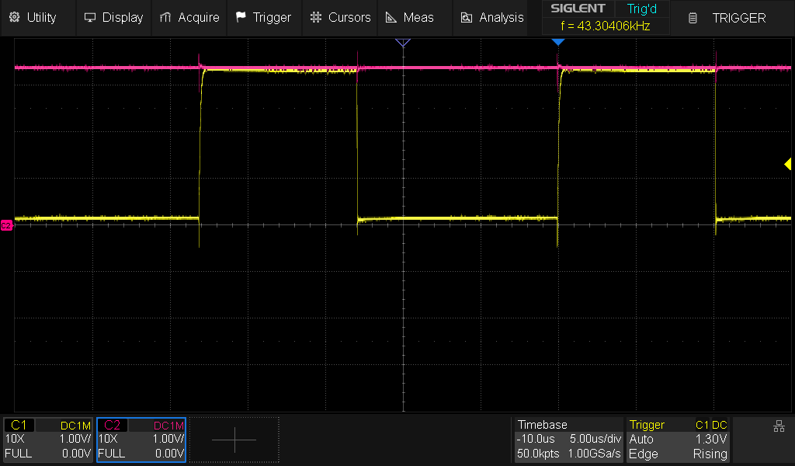
I2C DEMO BIT CONTROLLER
Bit controller: write “0”
Bit controller: write “1”
Notes:
Here are the oscilloscope readings for the write command:
the left image is the controller writing bit ”0” to the I2C bus
The right image is the controller writing ”1”
The read condition is similar to the write condition, just that the MOSFET will be not asserted (so the master is not driving the signal) and the FPGA will read the value of the data line that would be driven by another device.

Slide 34
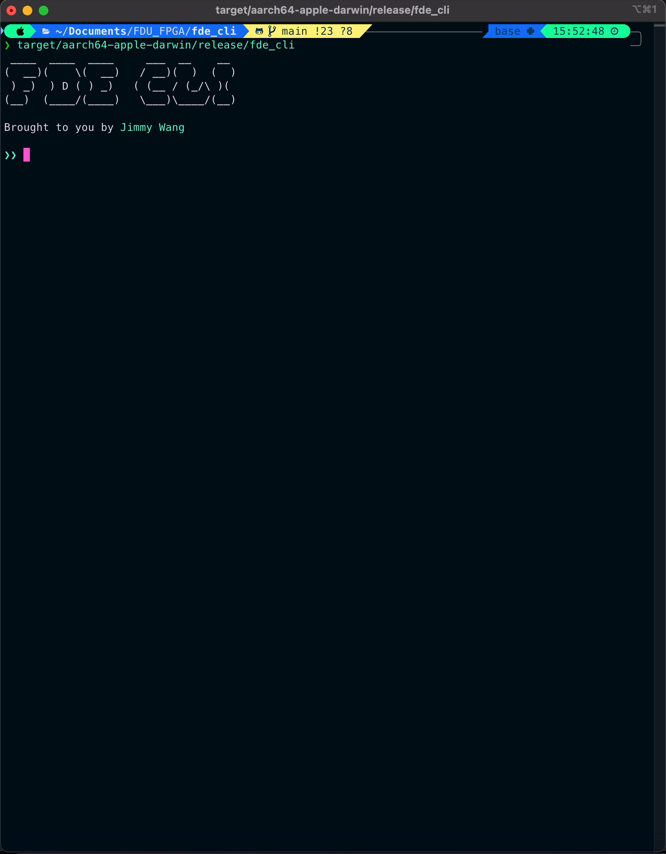
FDE-CLI DEMO AFIFO
Objective
Demo an asynchronous FIFO implemented on FDE
Two AFIFOs (TX & RX) linked to each other
Foundation for I2C module in the future
Clock-domain FIFO
SMIMS engine clock based on FDE-CLI
Internal 30MHz clock driving the I2C module
Write & read “1”, “2”, “3” to & from the AFIFO
Notes:
For the final part of my presentation, I will demo the asynchronous FIFO.
For the demo, I implemented two AFIFOs (a TX and a RX) and they are linked to each other.
This will lay the foundation for the I2C module in the future.
And the purpose of this demo is to show the FIFO working between different clock domains.
One clock domain is the SMIMS engine clock
The other clock domain is the internal 30MHz clock that would be driving the I2C module
In the demo, I proceed to write 1, 2, 3 to the TX AFIFO, and then read 1, 2, 3 from the RX AFIFO.

Slide 35
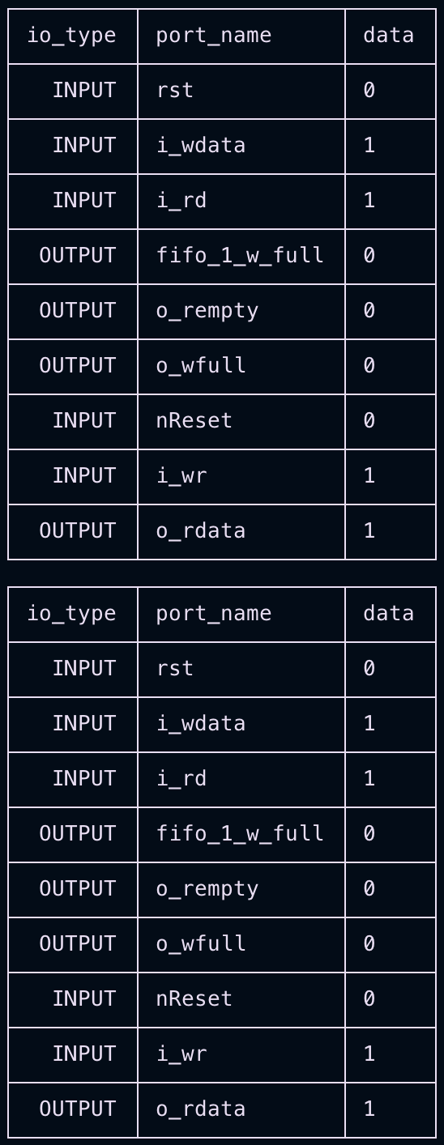
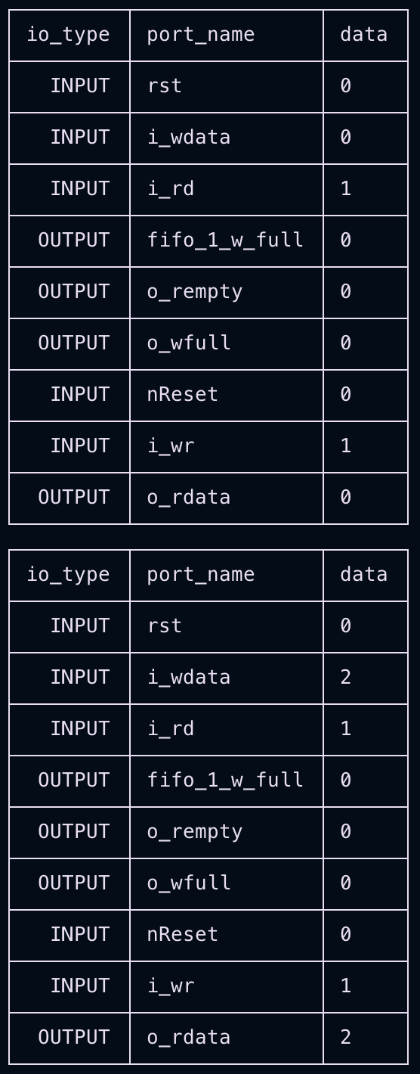
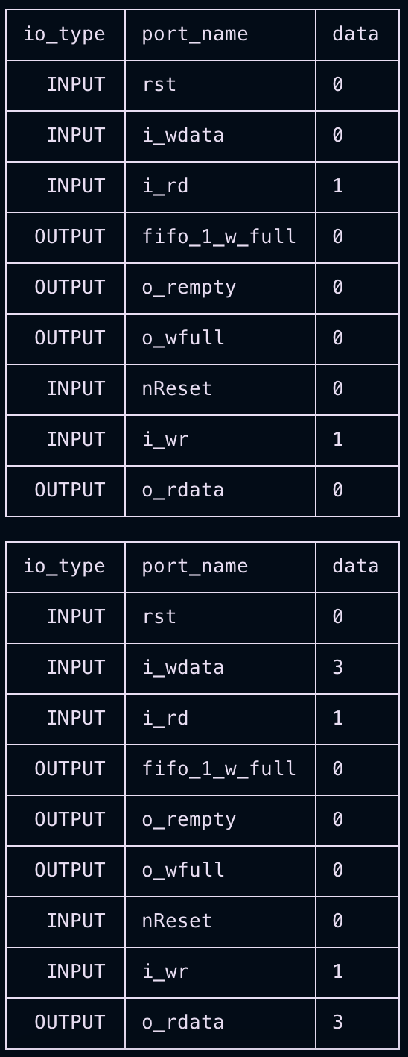
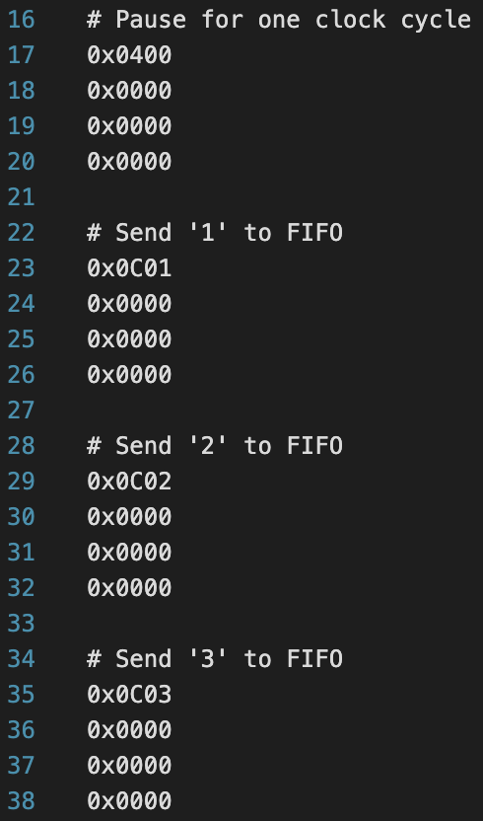
Data sent to SMIMS TX FIFO
Notes:
On the left-hand side is a snippet of the data sent to the TX asynchronous FIFO, and the snippets on the right-side show data read from the receiving asynchronous FIFO displayed in the FDE-CLI.
As we can see in the portions traced out in red, the output data of the receiving asynchronous FIFO shows 1, 2, 3.
Seems like the FIFO is working properly to transfer data between clock domains.

Slide 36
Future Work
Hardware wise
Finish the I2C controller & byte controller modules
Solder an open-drain circuit for the two signal lines (SDA & SCL)
Software wise
Finish implementing basic features for FDE-CLI
Integrate with FDE board with a AFIFO for cross-clock domain data sharing
Finish implementing my I2C IP with FDE-CLI
Experiment with communicating with some real I2C modules (temperature sensors, etc.)
Notes:
In the future, from the hardware point of view, I plan to:
Finish the I2C controller & byte controller
Solder an open-drain circuit for the two signal lines (SDA & SCL)
From the software point of view, I plan to:
Finish implementing basic features for FDE-CLI
Integrate the CLI with the FDE board with an asynchronous FIFO for cross-clock domain data sharing
Finish implementing I2C IP with FDE-CLI
Experiment with communicating with some real I2C modules such as temperature sensors, accelerometers, etc.

Slide 37
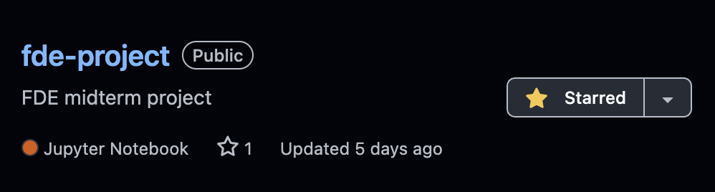

Open source
FDE Project
FDE-CLI
VLFD-RS
https://github.com/jwwang2003/fde-project
https://github.com/jwwang2003/fde-cli
https://github.com/jwwang2003/vlfd-rs
GitBook Blog
https://junweiwangs-organization.gitbook.io/fpga-stuff/i2c-protocol/i2c
Notes:
To end if off, all my projects are open source on GitHub.
The I2C module will come soon, once I am done implementing it.
I also have a GitBook blog which has more documentation and blogs on the experiments I did that were not included in the presentation and report, and it is still being slowly updated.
So maybe these things would be helpful for students taking this course in the future.

Slide 38
Thanks For Listening
Notes:
Thanks for listening, this concludes my FDE midterm presentation.

